Slide 1

Cleaning bad data
Part 2

Slide 2

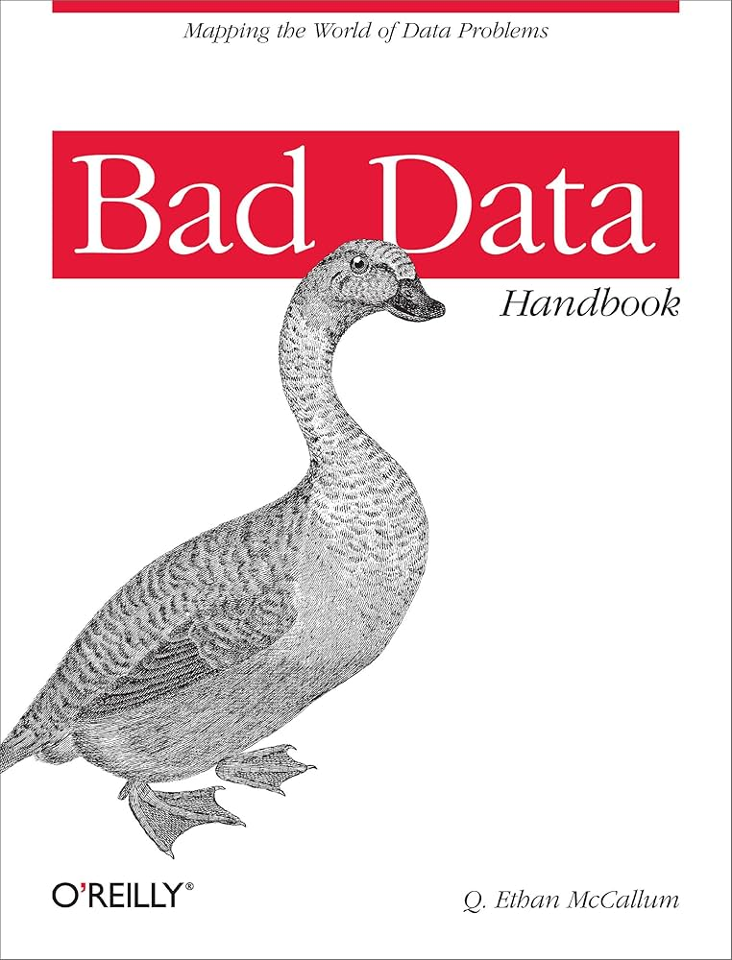
Resources
JA Roderick, Rubin DB. 2019. Statistical Analysis with Missing Data.
QE McCallum. 2013. Bad Data Handbook.
Van der Loo M., de Jonge E. 2018. Statistical Data Cleaning with Applications in R

Slide 3
Last chapter summary
Defining data: it’s never truly objective or factual; it goes through multiple processes of subjective interpretation and possible mistakes
Data analysis plan, and what to put in it
Rundown of what you have to measure, how to do it, with which tools, and what to present depending on what your clients or stakeholders expect

Slide 4
What we will do today
Last class was just a quick review of how to prepare a data project, and what you should think about
This is the main part of the course
We talk about bad data: what it is conceptually in your work, the different “kinds” of bad data
  Outliers, validity, missing data, measurement error…
Data cleaning: how to “clean” the bad data
And also bias
  More on that later

Slide 5
Data collection
In 6 years of work, I have never had to collect the data myself
It is a specialized job that depends on the nature of the data
  Data engineer, social scientists that know how to design questionnaires…
Setting up a data collection pipeline can be very long
  If it’s a small project on public data, it can be a matter a few hours/days
  For a nationwide questionnaire, collection can last months (or a year)
  For administrative data, it’s years of decisions
Ideally, the data collection is made with the subsequent analysis in mind
  But this is not always the case
  Administrative data especially, is not made for data analysis
Notes:
It is not actually your job to collect the data
Questionnaire : meetings with stakeholders, other institutions, working groups, need to decide what data to gather, which method, how many people, etc. etc.
Then you need a pilot to test it, to be sure that people understand it and to tackle any potential problems that may arise
Then you need to administer it (usually through a polling firm, like l’IFOP, Kantar…)

Slide 6
Data collection
You not collecting the data is problematic, but unavoidable
You might miss:
  Context
    Did an external factor affect the data collection?
    Were some people overlooked?
  Reaction/interpretation (for people)
    Did people understand what is asked?
    Are they likely to lie, or not reveal their true response/opinion/behaviour…
  Data treatment
    Is the data already modified? How many layers has it gone through before you receive it?
Notes:
Some people are hard to reach (elder people, minorities…)
Some data you access can already be heavily modified, and you might need to go through a very long documentation to be able to understand how to use the data.

Slide 7
Data collection
I won’t teach you how to collect data, the mechanics are too dependent on projects, fields and domains
However: get familiar with the process behind the data collection
This will influence a lot of the problems we will see right now

Slide 8

Just got my data…
Very first step as soon as you get your data: look at it
But don’t jump straight into the analysis:
  Check each (relevant) variable
  Think about how it has been gathered in real life
  What its distribution should look like
  If there are missing values…
Every time you check a new dataset, you will conclude that some of your data is…
Notes:
Some don’t look at it.
LOOK AT IT.
Otherwise it’s like you wanna paint, but you don’t even know what colours you can use.

Slide 9

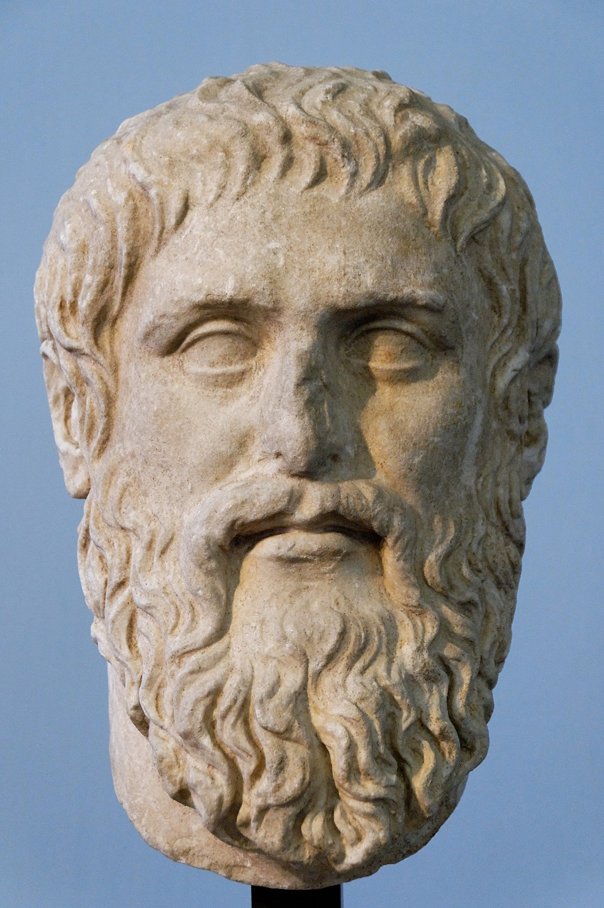
... bad
But what does it mean?
From last lab, do you have any example of bad data that you found?
Is the following bad data?
  Outliers?
  Missing values?
  A statistically non-significant result? A statistically significant result?
Notes:
The files themselves? The content? Variables? Their names? Types? Missing values?

Slide 10
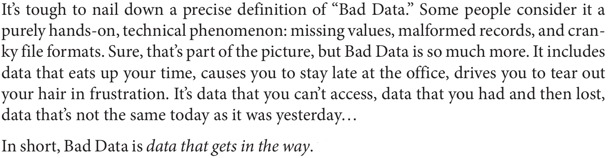
... bad
Bad data has multiple definitions and is open to interpretation, but the one from the Bad Data Handbook is nice:
“
”

Slide 11
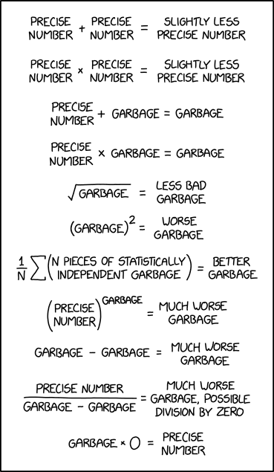
Why should you care? (1)
You could think: “whatever, I’ll start my analyses right away, why should I care if data is missing or unreliable?”
Well-known acronym in programming:
      GIGO
      Garbage in, garbage out
Your model and results are always as good your data, it is as important as choosing a correct model (if not more).
xkcd 2295

Slide 12

Why should you care? (2)
Philipp K. Janert:
“A scientist worth his salt is not there to crunch data. A scientist is there to increase understanding: […] understanding of the system that is the subject of the study, not just the data.”
Employability tips
Main selling point as social scientists: in economics, you’re first taught to think about the underlying systems, models, what happens in real life, before even tackling empirical work.
It’s the same when you do data analysis: you don’t just crunch data and show good metrics and p-values, you are there to understand the phenomena you observe with your data
Notes:
Data is just the lens/abstraction through which you observe reality. You are there to inquire about reality, find links and mechanisms that create relationships between phenomenon (variables) or that lead you to have the data that you observe.

Slide 13
Realities of the job
As a data scientist, expect to spend > 50% of your programming time on data wrangling and cleaning
  You don’t do enough of this during your studies, where you’ll instead spend 80% of your time learning complicated modelling methodologies
Also, having bad data can be very frustrating:
  Takes a long time that you might think would be better spent on analysis
  The more you clean, the less sure you are about the accuracy and validity of your analyses
  Might feel data quality issues severely undermine the quality of your work and your results
Notes:
Frustration: my example when I started working (I thought my work was bad because of all the data quality issues in the survey I was working on).
One of my interns: spent months on data cleaning, and felt really unsure about her results because of the difficult pipeline that she created
Counterpoint: I think it’s during cleaning that you learn to write good code and to be more efficient. Also, at some point, you realise that some things are out of your control, and you gotta make do with the data that you have. This doesn’t invalidate the hard work that you do.
You will never know if your data is good. Plus, different data scientists might do different cleaning for the same database. So they ultimately might not do the exact same analyses.0

Slide 14

Before continuing…
A few words of wisdom from Johanna Drucker:
  “The very concept of ‘cleaning’ data suggests elimination and purging techniques that should be approached with caution. Some forms of standardization may be engaged without violence to information, while others impose strong acts of interpretation.”
You may consider some data to be bad because it does not fit assumptions for your model, or because it does not fit your own beliefs
Your tools should fit your data, not the other way around.
Notes:
Data cleaning is a very subjective process
Especially if you clean it in such a way as to satisfy model assumptions: remember that assumptions are… opinions about how your data behaves. (:
If you start deleting outliers or transforming all your data so that it satisfies some assumption, are you still analysing what you wanted to analyse in the first place?

Slide 15
Technical definitions of bad data
Not machine-readable data
Data that is made for human consumption, but not machines

Slide 16
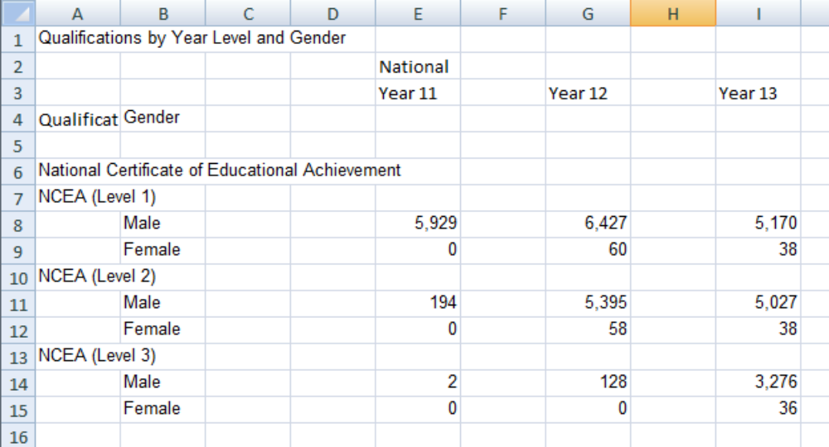
Help, R doesn’t get my data (1)
Terrible practice
You may find or have data delivered that is not in a readily usable state
Getting rarer as good data practices spread, however
Notes:
Why is it bad?

Slide 17
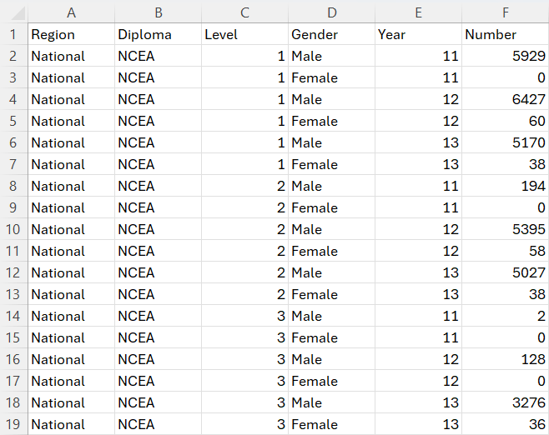
Help, R doesn’t get my data (2)
Proper data should look like this
  First row are variable headers
  Other rows are observations
  Each value should correspond to the
  Metadata (information about the data) goes elsewhere, in another sheet or file

Slide 18
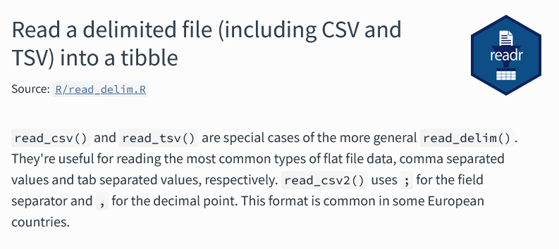
Bad tables to good ones
Check options in the function you use for importing data: encoding, row skips, delimiters for non-standard csv files…
Check for packages/libraries that allow to extract data from files that are not usually used to contain tabular data (e.g. pdf files…)
If all else fails: rebuild the data by hand in Excel
  Bad practice though: no replicability, possibility of errors

Slide 19

Other non-tabular formats
Other examples of data that are not readily readable as tabular data:
  Data from web scraping
  Administrative data on paper
  Voice recordings (or people giving you information orally)
Can be a big project in itself
  E.g. digitizing old data that is on paper, you either pay people to put the data in files, or use optical character recognition (OCR) software
19th century French birth certificate

Slide 20
Technical definitions of bad data
Not machine-readable data
Invalid data
Data that do not meet some real-world rules or criteria

Slide 21

Invalid data
Most straightforward case of bad data: data that should not happen in reality
You observe your data, but some values violate some “rule”
  This rule may stem from common sense, industry knowledge/domain knowledge or other analyses
  You will have to work closely with the people that have been working long in the field and who are familiar with what happens in reality, they will help you establish “rules” to define invalid data
You can use the following list as some general guideline, you will ask yourself the same questions for any datasets
Notes:
Ground experts: talk about Guilhem

Slide 22
Invalid data: checks (1)
Data types
  Is the variable of an expected data type?
  Remember last lab, when you tried to merge all the datasets and it did not work: it’s because some variables did not have the same type across tables
Range and distribution of continuous values
  Look at the distribution, are the extreme values possible? (e.g. a negative age, or an age of 140 years)
  Does the distribution of the data make sense according to domain knowledge?
Distribution and values of categorical variables
  Are there modalities that should not exist?
  Does the distribution of the modalities make sense according to domain knowledge?
Notes:
Example of helicopters in emergency service data

Slide 23
Invalid data: the checks (2)
Duplicates
  The same data may be entered multiple times, check identifying variables
  Though sometimes, the same person may have different IDs…
Impossible combinations of values
  The values of some variable may restrict the possible range of values on another one
  E.g. in a dataset of individuals containing marriage status and age, age should not be under 18 (in France) if the person is married
Totals
  Are some variables totals of other variables? Are they still valid if you recompute them?

Slide 24
Invalid data: how to manage?
Correction
  If you know a way to recover the “true value”: modify the variable
  E.g. recompute a total, merge modalities for a categorical variable, modify its type or correct the chain of characters…
Deletion
  If you cannot correct it, you better delete it instead of using it
  In this case, treat it as missing (we will see that right now)

Slide 25
Technical definitions of bad data
Not machine-readable data
Invalid data
Missing data
Data that is not there. NAs, empty rows or columns…

Slide 26
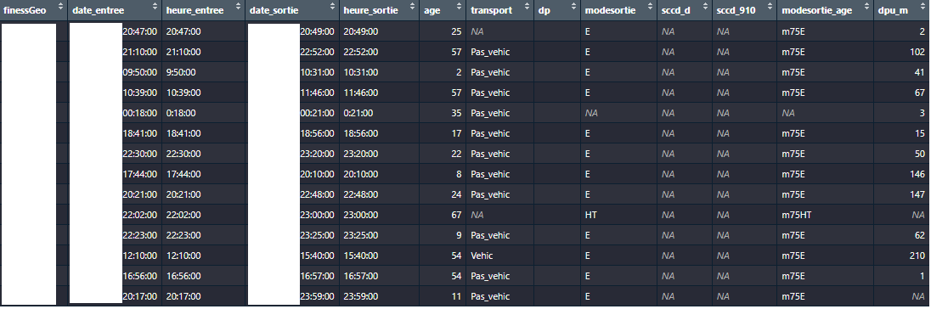
Missing?
xxx
Confidential (:
Also confidential (:
This too (:
xxx
The archetypal example of “bad data”
Instead of actual values, you have NAs (or some type of string that indicate the data is missing : “”, “ “, “x”, “xxx”, “na”, “missing”, “.”)
  Watch out for this: in R, missing values should always be NA

Slide 27
But why is it missing?
Did you ever wonder why your data was missing?
Tons of reasons, actually:
  People may refuse to report data, especially if the data is sensitive
  Basic human error (if data is gathered manually)
  Weird software quirks or failures
  Hardware failures
  Bored people inputting joke data
  Deliberately malicious responses in surveys
  People not knowing what to respond in a survey
Notes:
The person inputting the data was bored, or it was deliberately malicious: example of emergency care workers putting some diagnostics as a joke, like “Volcanic eruption at home”. Or, in surveys, people that deliberately answer wrong. Note: some people may argue that it is still valid data (I don’t entirely agree).

Slide 28
What do I do?
Check how much of it is missing:
  If a ‘substantial amount’ (to be determined) of it is unusable, don’t bother, unless you can reconstruct the variable from another source of data
  Can be frustrating, but at some point you need to make do with what you have
Check if there is a mechanism or pattern
Notes:
Sometimes you have to make do with the data you have. If an entire column is not usable, you can’t do anything about it, and trying to salvage it might make it worse.
Also, sometimes it is better to have missing data than being unsure of the validity of a whole column

Slide 29
Mechanisms and patterns in missing data
Rubin distinguishes patterns and mechanisms
Patterns: “which values are missing and observed in the data”
Mechanisms: “relationship between missingness and the values of variables in the data”, that is, why your missing values are missing

Slide 30
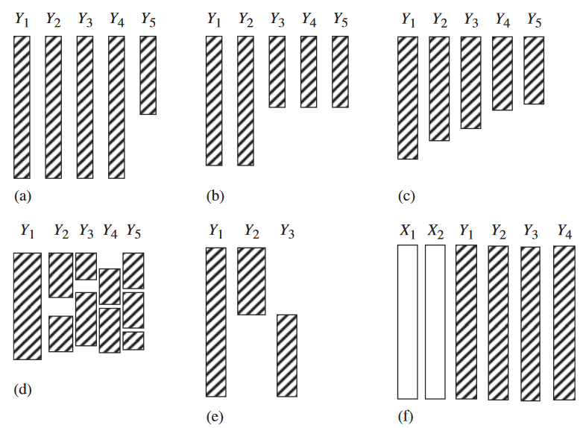
Patterns in missing data
Rubin defines 6:
Univariate nonresponse (a)
Multivariate nonresponse (b)
Monotone nonresponse (c)
General nonresponse (d)
File matching (e)
Latent variables (f)
Notes:
I don’t know how useful it is to know this

Slide 31
Patterns in missing data
Univariate nonresponse
Missing data in a single variable. Simplest case, but it is quite rare to have missing data in a single variable, I think.

Slide 32
Patterns in missing data
Multivariate nonresponse
Missing data in multiple variable, with the same pattern of missing data.
Frequent in surveys, when respondents stop in the middle of it.

Slide 33
Patterns in missing data
Monotone
Typically happens in longitudinal studies (surveys through time over the same observations) due to attrition (people stop participating)

Slide 34
Patterns in missing data
General nonresponse
Most common type. Missing data in multiple variables, for different observations.
Depending on the type of data, and with some deletion, a monotone pattern can be achieved

Slide 35
Patterns in missing data
File matching
Multiple variables with missing data, but we never observe the missing data in the same rows.
Happens in practice, need to explore further: missing values for each variables could be dependent on other variables

Slide 36
Patterns in missing data
Factor analysis with two latent factors and four measured variables
A latent variable is unobserved data that you can infer from observed data.
Very common in questionnaires

Slide 37
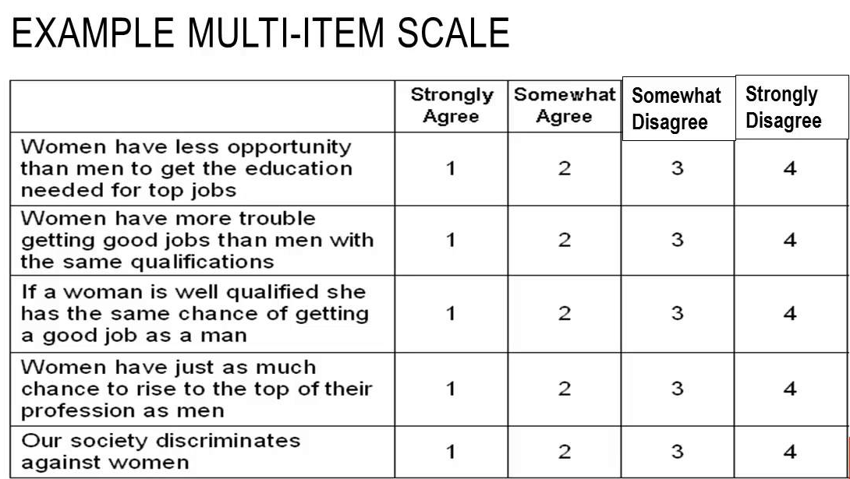
Quick explanation of latent variables
Latent variable: perceived disadvantage of women at work
Positive correlation
Positive correlation
Negative correlation
Negative correlation
Positive correlation
When you have multiple highly correlated variables that share a common underlying theme, you can combine them as one unique variable using dimensionality reduction techniques (e.g. PCA, MCA…)
Notes:
We usually do this to create variables that are hard to measure: happiness, political affiliation, quality of life measures, opinions… We can’t ask these questions directly, answers are not very reliable.
Super common in statistics. Famous example: french deprivation index

Slide 38
Mechanisms in missing data (1)
Patterns were what values were missing in your dataset
Missing data mechanisms refer to the real-life processes that leads your data to be missing
There are three, according to Rubin

Slide 39
Mechanisms in missing data (2)
The “easier” ones:
  Missing completely at random (MCAR): missing data does not come from observed or unobserved factors
  Missing at random (MAR): missing data comes from observed factors
  E.g. in an income survey, earners from a particular sector (which we know in the data) are less likely to report their income
MCAR is unrealistic. This assumes the missing data comes from pure chance. This is not testable.
MAR is more realistic: there is an association between missingness and one of the variables in your data. You can test it.
Notes:
The name MAR is a bit misleading, I think it should be called « missing conditionally at random »

Slide 40
Mechanisms in missing data (3)
The “worse” one:
  Missing not at random (MNAR): missing data comes from an unobserved factor that you do not have in your data
  E.g.: in vaccination surveys, vaccine hesitant people may be more likely to not respond than say they don’t trust vaccines
In real life, this may be the most common mechanism
The problem is that it is hard to diagnose and to resolve

Slide 41
Meaning in missing data
Missing data may, in fact, mean something
If that is the case, its meaning is usually found in the data dictionary, or through people that created/gathered the data
Survey nonresponse can be a special case of missing data:
  For some questions, nonresponse can be very telling…
  “How often do you recommend vaccination to patients?”
  “What is your opinion on general vaccination”, or “… on XYZ vaccination?)
  Despite not giving any response, this can be interpreted as avoidance or reluctance: this missing data can be used in analyses, or be grouped with negative answers (these respondents could very well have poor opinion of vaccination, but prefer not declare it!)

Slide 42
Solutions to missing data
We will see the two most common ones for MAR and MCAR: deletion and imputation
The other big one is likelihood-based approaches
  I will kindly refer you to JA Roderick, Rubin DB. 2019. Statistical Analysis with Missing Data.
  This can handle MNAR data, because you explicitly model the missingness mechanism
In my experience, most opt (mistakenly?) for simple or multiple imputation, though you may often argue that missing data is MNAR
  In my opinion, this could be due to lack of knowledge about other methods, and mostly lack of time and expertise to model the missing data mechanism…
Notes:
Reason why we mostly do imputation: time and lack of knowledge about more complicated methods, I guess. It’s very time consuming to do, and you don’t have infinite time when working on projects. We are usually aware of these limitations.

Slide 43
Deletion
Worst solution: delete all rows with missing data (a.k.a. “complete case analysis”)
Do this only if you have few missing values over few variables
  “randomly deleting 10% of the data from each variable in a matrix of five variables can easily result in eliminating 59% of cases from analysis”
Obvious risks:
  Loss of statistical power & accuracy
  More conservative estimates (i.e. less likely to find significant results)
Less obvious risks:
  Your data might not look like your population (i.e. reality) anymore, this is extremely problematic
  Check the characteristics of your kept observations: must be similar to excluded observations
Notes:
Example: in a questionnaire

Slide 44
Simple imputation (1)
Replace missing values with a single value, based on other rows in your data
Can be obtained through multiple methods, from the most simple to most complicated
Easiest is imputation by the mean or median:
  Calculate the mean (or median) of the variable among observed values
  You can stratify by the values of one or multiple categorical variables, for better accuracy
  Easy to do in R, with dplyr in a mutate: using a case_when, replace only missing values with the mean or median of the variable

Slide 45
Simple imputation (2)
There also are model based approaches:
Hot deck
  Form of nearest neighbour imputation
  Select one random observation that is identical (or very similar) to the one with the missing data
  Use the observed value of this random observation as imputation
Regression (or any ML model):
  Fit a model on the observed data, with regressors of your choice
  Predict missing values using the trained model

Slide 46
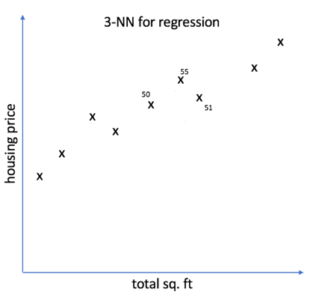
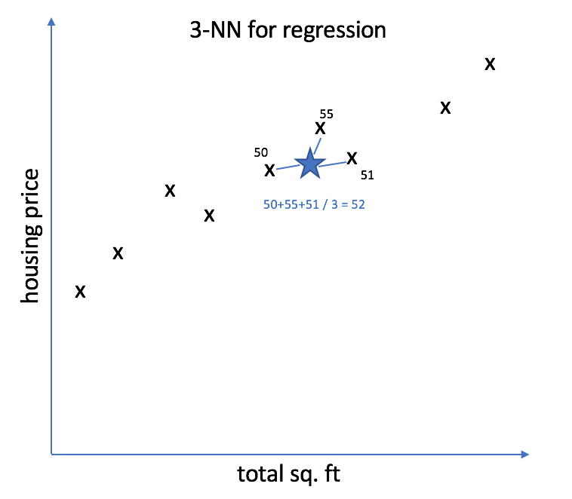
Simple imputation (3)
One missing value to impute:
Take mean of target variable of the 3 nearest neighbours
Three nearest neighbours to observation with missing data
kNN imputation
  More sophisticated than hot deck: instead of only one, select the k nearest neighbours to the data point you wish to impute
  Take the average observed value of these k nearest neighbours

Slide 47
Multiple imputation (1)
There is always uncertainty when imputing however: you will never know the true value behind the missing data
One way to solve this is to introduce variability in the imputation process by repeating it multiple times

Slide 48
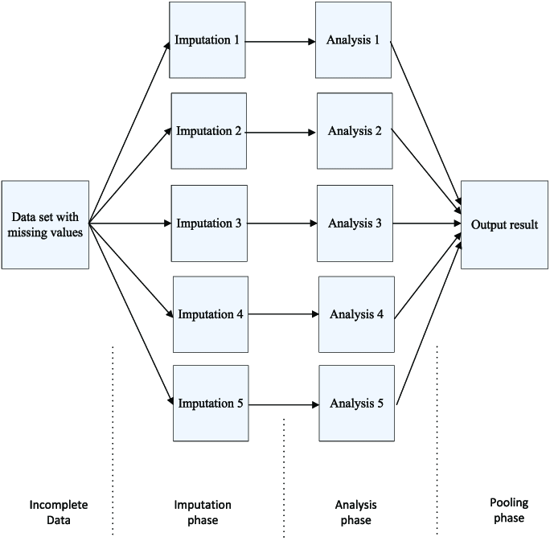
Multiple imputation (2)
Create multiple datasets, with different imputed values using models that allow some variability in the predictions
  E.g.: stochastic regression, Random Forest
R packages:
  mice (multiple imputation by chained equations)
  miceRanger (mice with Random Forest)

Slide 49
Limits of imputation (1)
It is not a magic bullet, there are situations where imputation will not help you:
  You have too much missing data
  When the data is MNAR: this will make your data even less representative of reality. You must take into account the process that creates missing data.
  This may not be usable in some contexts: in longitudinal data (where you follow the same patients over time), imputing data for respondents with missing data from one year to the next should not be done!
Notes:
Longitudinal: reason is that you risk imputing, for some variable for person x at time t, an average that is totally unrelated to the value of the variable at time t-1 or t+1
Some don’t trust imputation at all: it is common practice in big national surveys to have missing data already imputed, some researchers or data scientists immediately drop this data

Slide 50
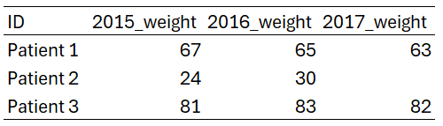
Limits of imputation (2)
Example of where imputation would fail on longitudinal data:
If you blindly took the mean of the 2017 weight across patients to impute the weight of patient 2, it would be totally incorrect
Think about what your imputation means in the context of data
Notes:
Ask students why taking the mean of 2017_weight would not work

Slide 51
Technical definitions of bad data
Not machine-readable data
Invalid data
Missing data
Outliers
Data that is “abnormal” with regards to other values
Notes:
Credibility: in the data of an emergency service, if half of patients come by helicopter (which is not possible in real life), then you can safely assume the data is very unreliable. Problem is: now you don’t know how much of the data is really usable.

Slide 52

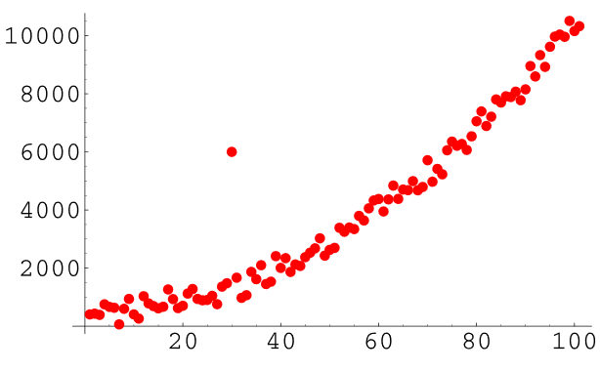
Outliers - Examples
Can you find the outlier here?

Slide 53
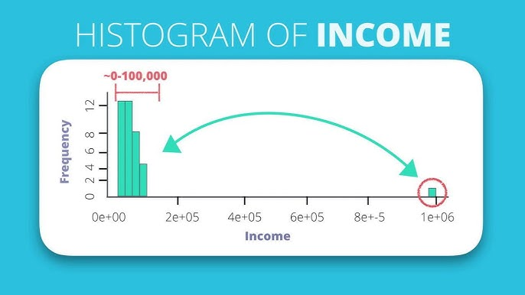
Outliers - Examples
And here?

Slide 54
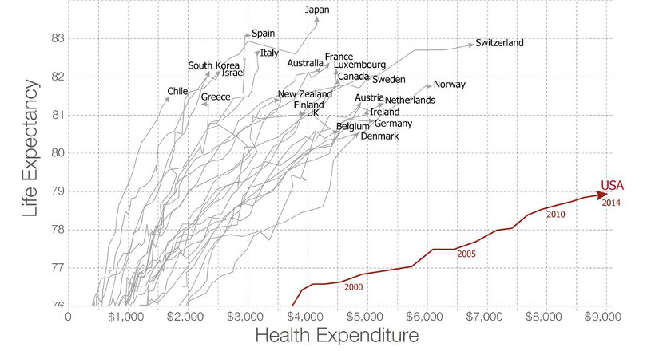
Outliers - Examples
What about this one?

Slide 55

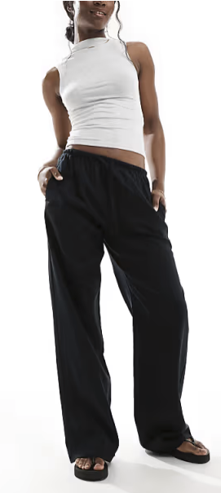




Outliers - Examples
Here?
Notes:
Explain the example

Slide 56
Outliers
An outlier is any data point that is substantially different from others, in the context of the dataset
Would you delete it?
Impute it?
Notes:
Why would you not impute it?
By deleting it, you will make the choice of not modeling it.
Examples:
* Merging non-binary persons with another gender (due to lack of statistical power for them)
* In my experience, overseas France may be considered outliers or not considered in analyses

Slide 57
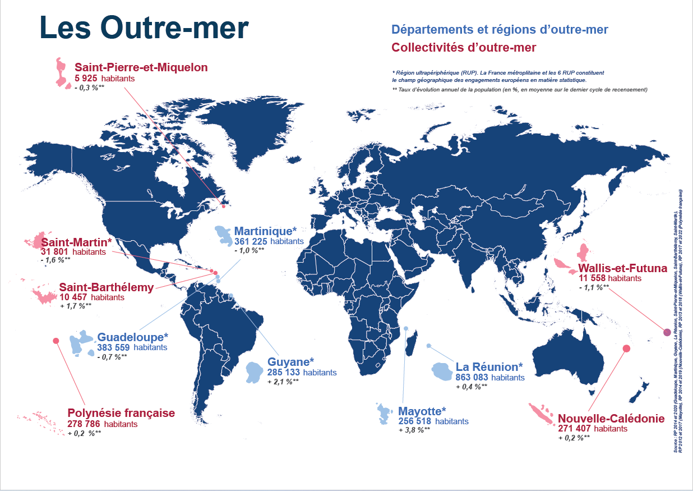
Outliers
An outlier is any data point that is substantially different from others, in the context of the dataset
The usual method of dealing with outliers is deletion
  You would not impute it or modify it, because an outlier is valid, it exists in real life
  Remember that deletion technically means: this data point does not exist in real life
Food for thought: minorities are, in a way, outliers
Notes:
Why would you not impute it?
By deleting it, you will make the choice of not modeling it.
Examples:
* Merging non-binary persons with another gender (due to lack of statistical power for them)
* In my experience, overseas France may be considered outliers or not considered in analyses

Slide 58
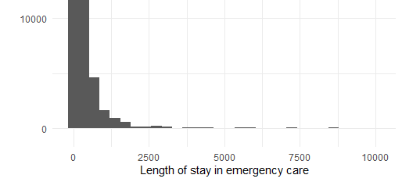
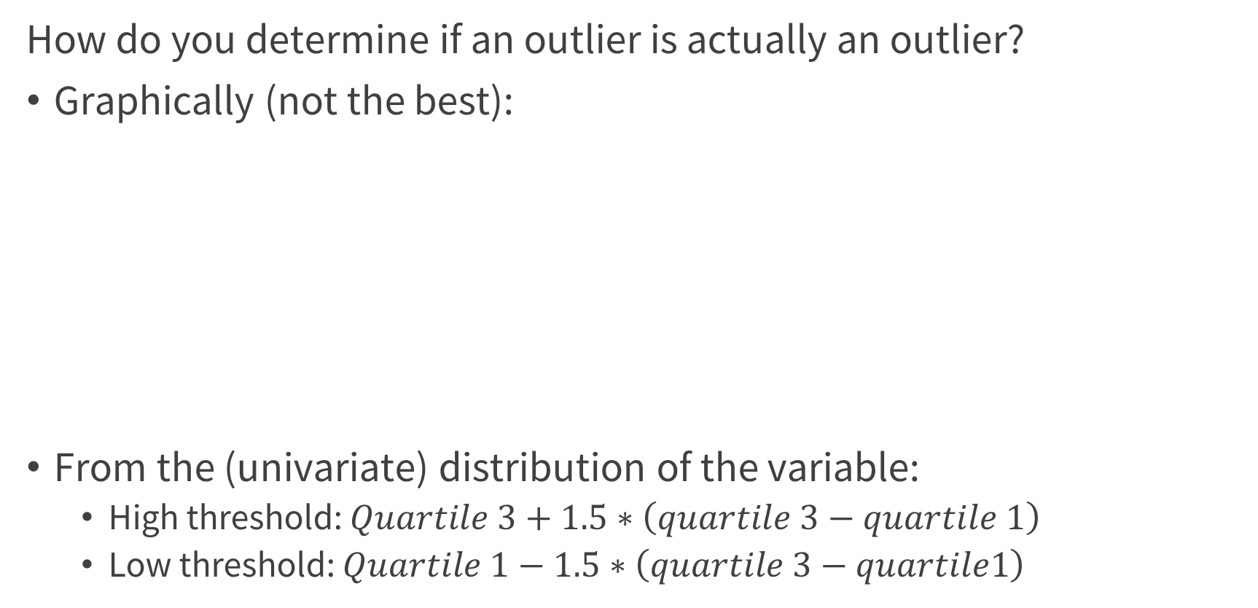
Finding outliers (1)
How do you determine if an outlier is actually an outlier?
Graphically (not the best):
From the (univariate) distribution of the variable:
  High threshold: $Quartile 3+1.5∗\left(quartile 3−quartile 1\right)$
  Low threshold: $Quartile 1−1.5∗\left(quartile 3−quartile1\right)$
What would be the threshold?
N
Notes:
Why 1.5? Something to do with the gaussian distribution
You can change this, by the way. It’s not set in stone. You can choose 2, or 3, if you want to be really stringent. Plus, you should not use this threshold if your data is not normal.

Slide 59
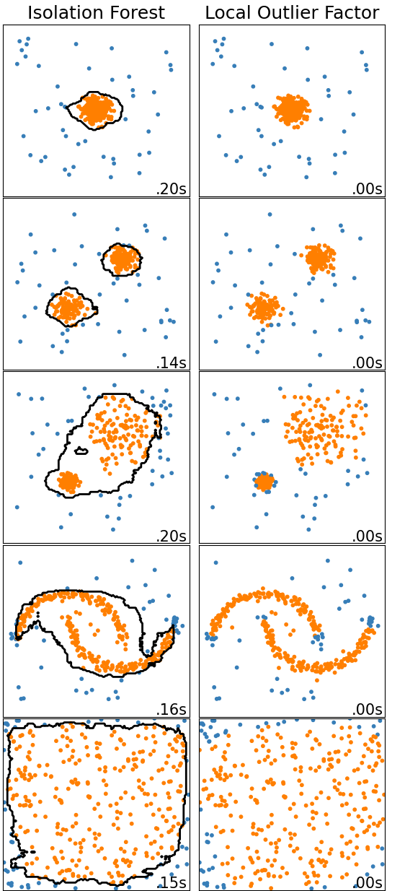
Finding outliers (2)
Automated detection methods:
  Local outlier factor: calculates density around each point and assigns a score (higher values -> more likely to be an outlier)
  Isolation forest: recursive random partitioning of the data, observations that are alone after few partitions are more likely to be outliers
Detection can be done over multiple variables. But it is more of a black box. Also, you still need to define a threshold.
There are others (search on scikit-learn, or online)
Notes:
Never have had the use of these methods, personally. It’s there if needed.
Threshold: at which value of the score do you decide to define data points above it as outliers

Slide 60
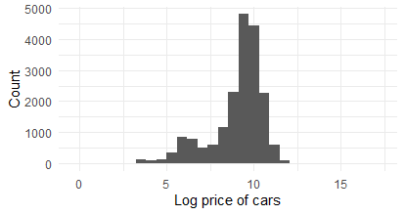
Finding outliers (3)
Nothing stops you from combining methods, though with most techniques, you need to define a threshold
Outliers are usually deleted…
  But don’t erase data blindly, consider first whether it is really an outlier, and then whether it is information you actually want to discard
  Not all modelling strategies are sensitive to outliers: it’s less of a problem with, let’s say, random forest
Do you delete the 20 million dollars car?
Notes:
In data science, you will often have to define thresholds: here for outlier deletion, but also for example, after a logistic regression

Slide 61
Technical definitions of bad data
Not machine-readable data
Invalid data
Missing data
Outliers
Measurement error
Valid data with incorrect input

Slide 62
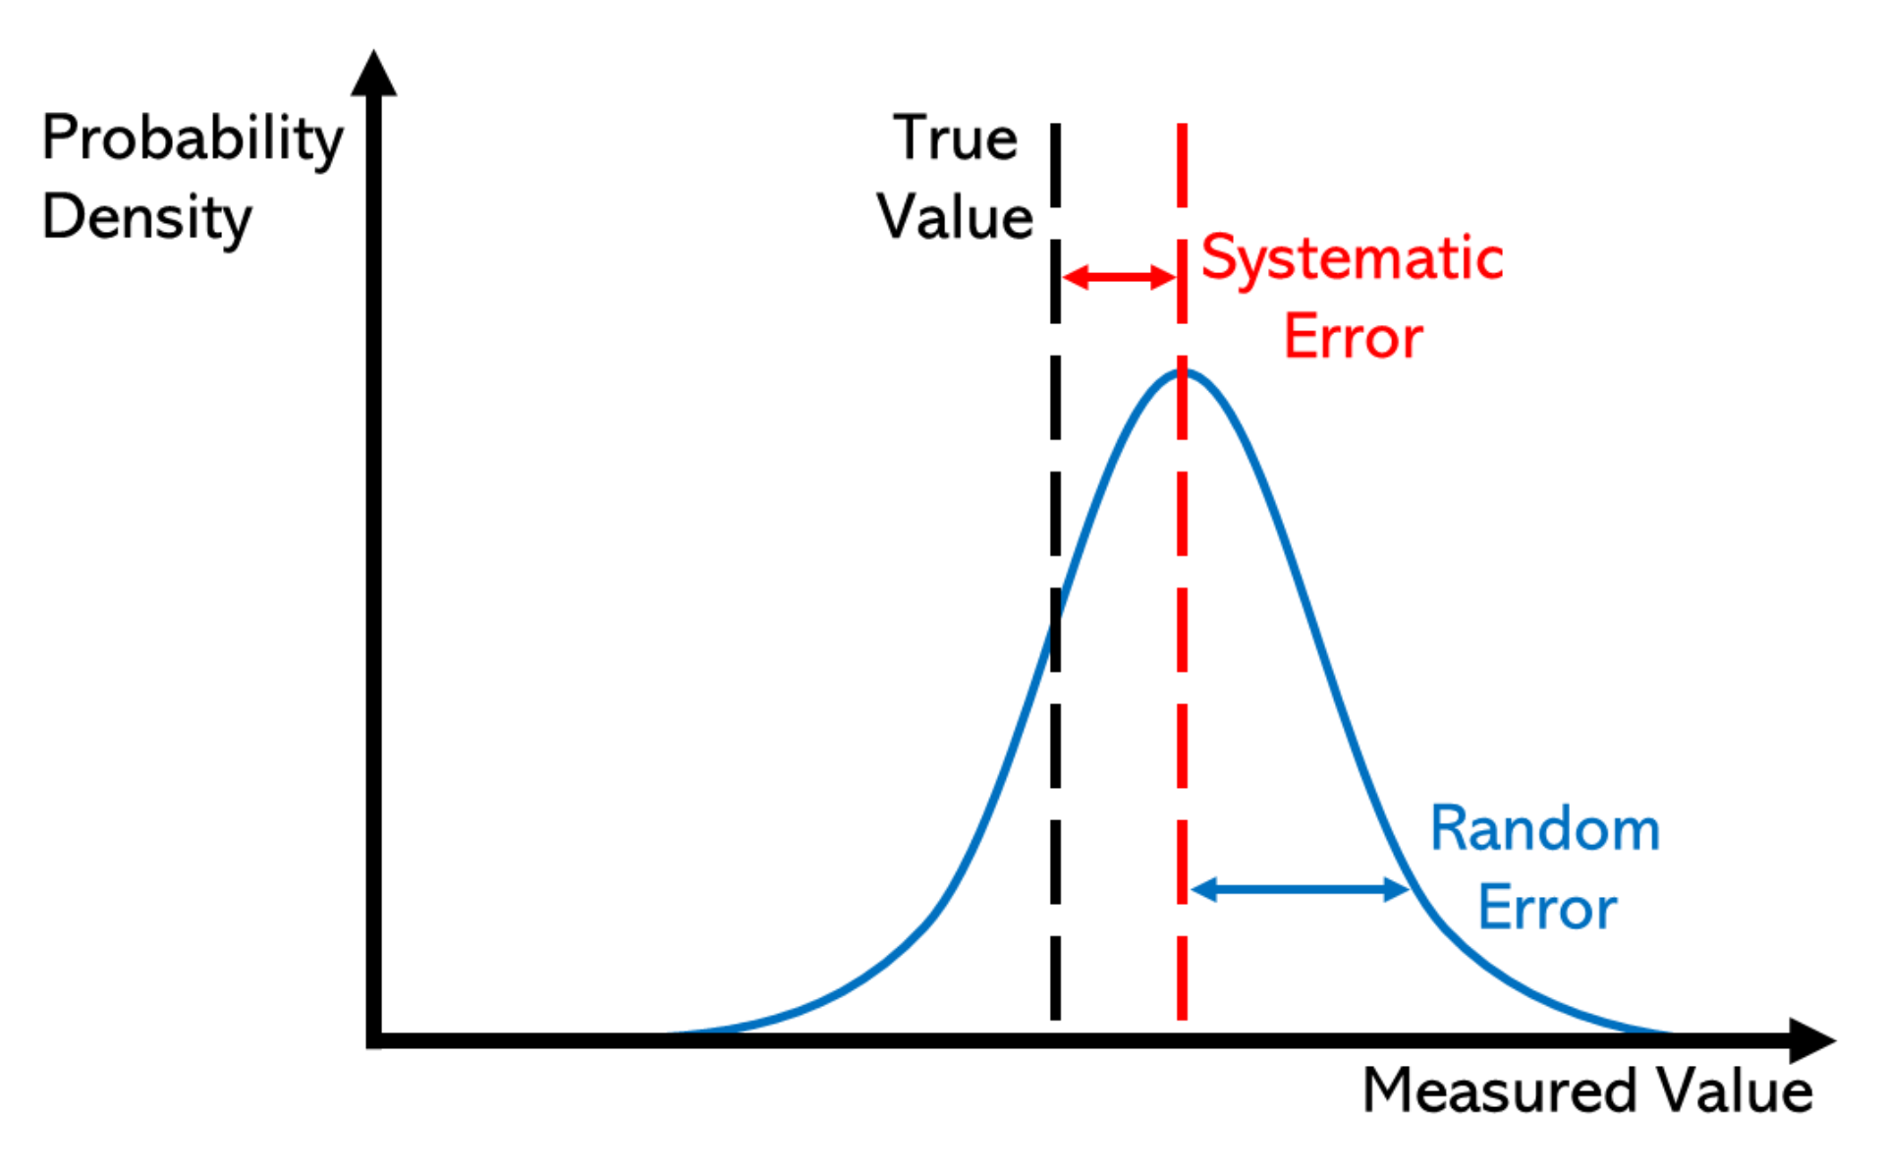
Measurement errors: definition
Sometimes, values in your dataset can be valid (i.e. they can happen in real life) but still be different from their true values
In my opinion, this is the worst case of “bad data”:
  You may never know that your data is inaccurate
  If you know there are measurement errors in a variable, you may not know where
Measurement error can be:
  Random, this increases the variability in your data
  Systematic error, the measurement error will always be the same and lead your data away from its “true value”
You could also call this “bias”
Notes:
Random: think of it like some faulty equipment that randomly moves your data points away from their true values. Like a scale that randomly adds or substracts up to one kg

Slide 63
Measurement error: detecting from outside the data
At this point, this is less data science, and
Real difficulty is that you can’t always spot measurement errors just by crunching the data:
  Ask people who collected the data, or experts who know what happens on the ground…
  Or go directly to where the data is collected (especially in manufacturing, for example)

Slide 64
Measurement errors: why?
Variety of sources
Could be human input that is at fault:
  Bored people gathering the data and inputting junk data
  Subjectivity
  Simple random error
  Incentives
Faulty hardware or software quirks:
  Improperly calibrated or poorly maintained hardware
  Software that outputs wrong data in specific circumstances (bugs)

Slide 65
Measurement errors: solving
If you know there is a systematic error but cannot figure out in which observations and have no idea how to correct it: forget about it, don’t use this variable
If you can determine where errors are, you could treat it like you would missing data
  Use the techniques presented previously
There is a lot more to it: techniques and models we can use to correct specific types of measurement errors

Slide 66
Measurement errors: examples
Emergency service data: each patient is assigned a severity score (scale of 1 to 5) when they depart
Financing reform in 2020: emergency services receive more funding when they treat “severe patients” (scale >= 3)
Of course, the proportion of severe patients suddenly rose after 2020
  Especially in private clinics…
This variable is unreliable after this date: we can’t know if some patients are really “severe patients” or patients with a severity score of 2 that was bumped to 3.

Slide 67
Measurement errors: avoiding
Once your data is gathered, you must deal with its problems and quirks either way…
But it is good practice to implement changes in how the data is collected
Report any incorrect measures, and how these came to be
  Realistically speaking, improving how the data is collected is not always possible, but it will never improve anyway if you don’t act on it

Slide 68


III. Biases, fairness

Slide 69
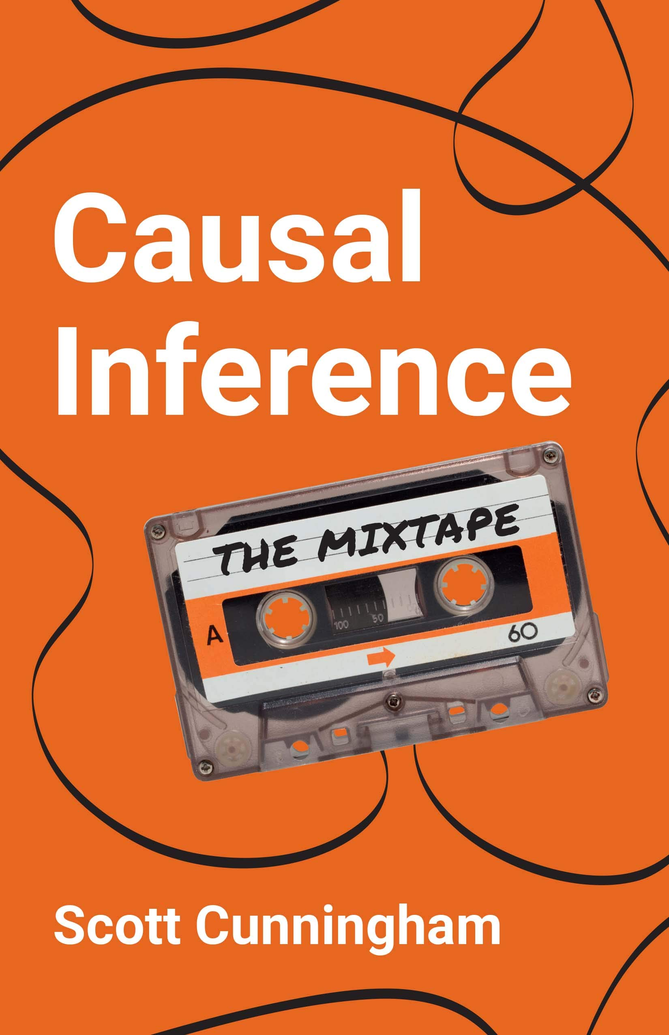
Resources
Causal Inference: The Mixtape
Free here: https://mixtape.scunning.com/
Fairness and Machine Learning: Limitations and Opportunities
Free here: https://fairmlbook.org/pdf/fairmlbook.pdf
Bias and Causation: Models and Judgment for Valid Comparisons

Slide 70
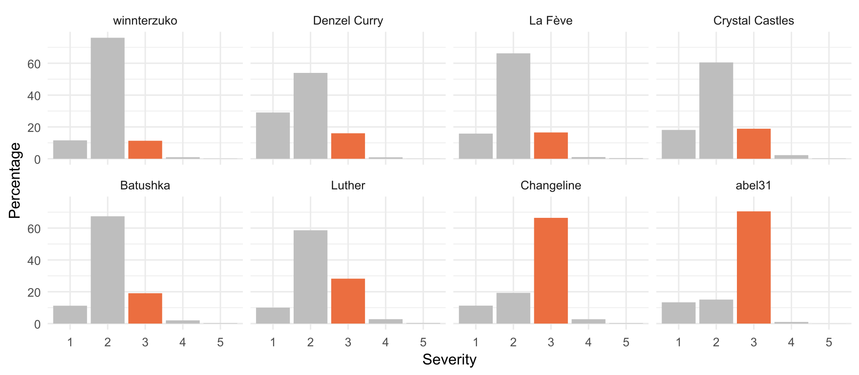
Bias (1)
Last lab, if you were quick, you could have verified the distributions of some variables
I introduced a measurement error in the “severity” variable. Unless I told you about it, you would be very likely to miss this.

Slide 71
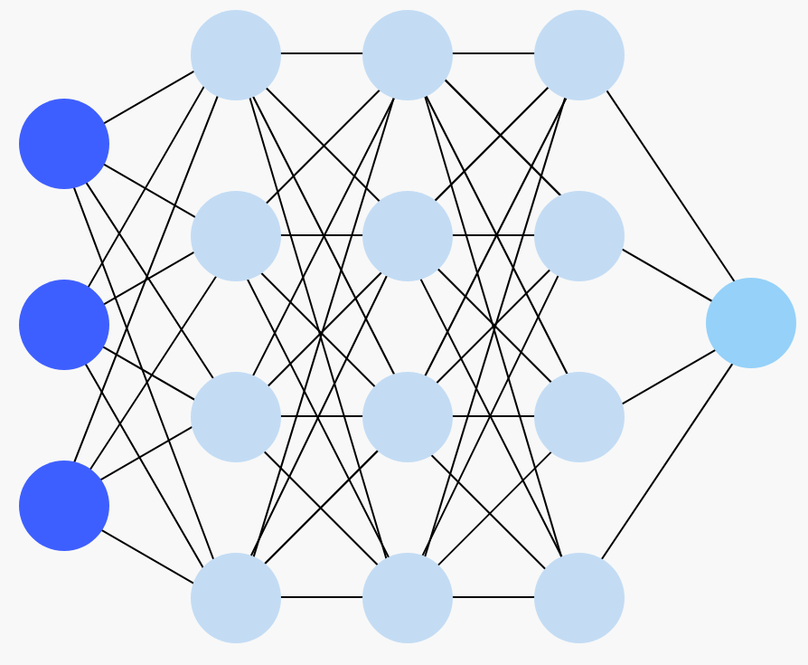
Bias (2)
This is one of the most challenging and critical issues you will find in your work:
  You can’t just solve it by throwing at it
  This requires research and expert knowledge on the data and how it is gathered
  These will be issues in your descriptive and modelling stages
What if the only data you had were these services? You wouldn’t even be able to observe this through data analysis
Notes:
In my opinion, it will be the second biggest challenge. The first one we will see it next course.

Slide 72

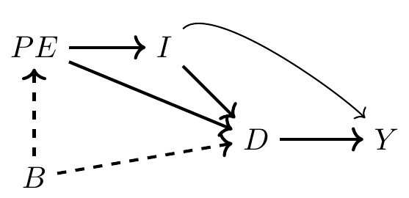
The big picture: causality…
Always has been
Bias is (un)fortunately linked to causality
  This takes whole courses, not just 20 minutes slides
causality
Wait… it’s all Ohio?
For great introductions, check out:
  Causal Inference: The Mixtape, by Scott Cunningham
    Especially the chapters on Directed Acyclic Graphs (DAG), backdoors, colliding and confounding variables… this will make you think twice about what you put in your models
  Causal diagrams: draw your assumptions before your conclusions
Also: Antonakis et al. 2010
Sorry.

Slide 73
Causal inference (1)
X
Y
At its core, causal inference is simply estimating the true impact of some event, policy, choice, attribute (i.e. some X variable) on an outcome (your Y)
  The challenge here is disentangling the true effect of X on Y from any other possible interference
Typical example: you want to know the effect of a vaccine on some disease
  How would you do that?
Notes:
Interference: variables that affect or are affected by both X and Y

Slide 74



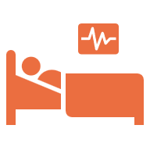


Causal inference (2)
Ideally, you would just create two identical universes: one where you take the treatment, one where you don’t
Universe A
Universe B
It’s a vaccine
Very
healthy
not steroids

Slide 75
Causal inference (3)
Unfortunately, you’re just an AMSE student and can only observe one situation
The key (and difficulty) of causal inference is finding a valid comparison
  We call that a counterfactual (what would have happened in the other situation)
Universe A
Universe B
?
Very
healthy

Slide 76













Causal inference (4)
A way to do this, is to create two groups with similar characteristics such that no (un)observed characteristic is correlated with both assignment to a group and the outcome of interest
  Randomisation is a good starting point, if possible (hence, why Randomised Controlled Trials are called the “gold standard”)
Group A
(Treatment)
Group B
(Control)
Notes:
So what does this mean really? Give example of giving a vaccine only to women, and the men are the control. Why wouldn’t it work?

Slide 77
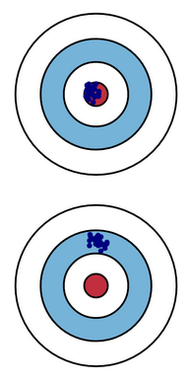
Bias
In your typical econometrics course, bias is the properties of an estimator: it is biased if, on average, it yields parameters different from their true values
  This is not due to the data, this is a property of the estimator itself
Here, we will consider bias as a systematic distortion of some causal effect, coefficient, or measurement of a variable, that make them different from their true values
  Rather than an estimator property, this here is due to methodological problems (during data gathering, analysis…)
Notes:
Ask students if they know of a biased estimator? Biased estimators: think shrinkage estimators, like lasso, ridge… Sometimes you can get more accurate predictions using methods that yields purposely « wrong » coefficients!
Systematic is key: you can have random bias, just a random distortion in some observations. Here, the subject is a distortion that is systematic: people that systematically report a wrong answer, a machine that is ever so slightly broken that it systematically underestimates or overestimates its measurement…

Slide 78
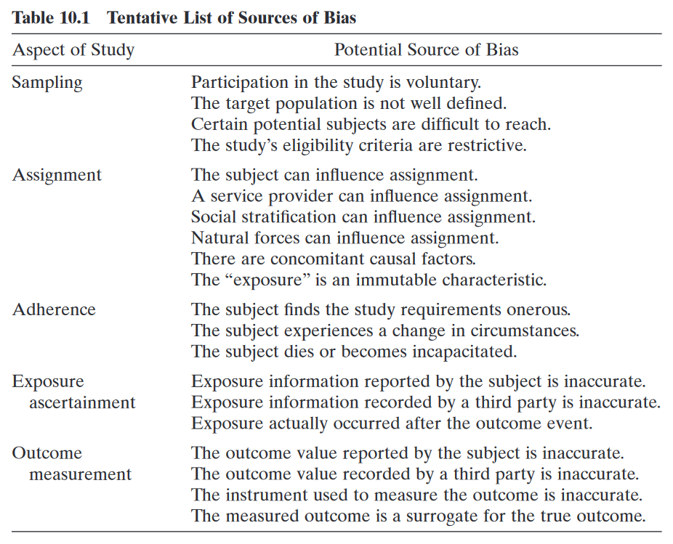
A Taxonomy of bias
1
Weisberg (Bias and Causation book) proposed a taxonomy of the main families of bias
Left: family
Right: examples of sources
2
3
4
We saw these earlier (I called that measurement error)
5

Slide 79
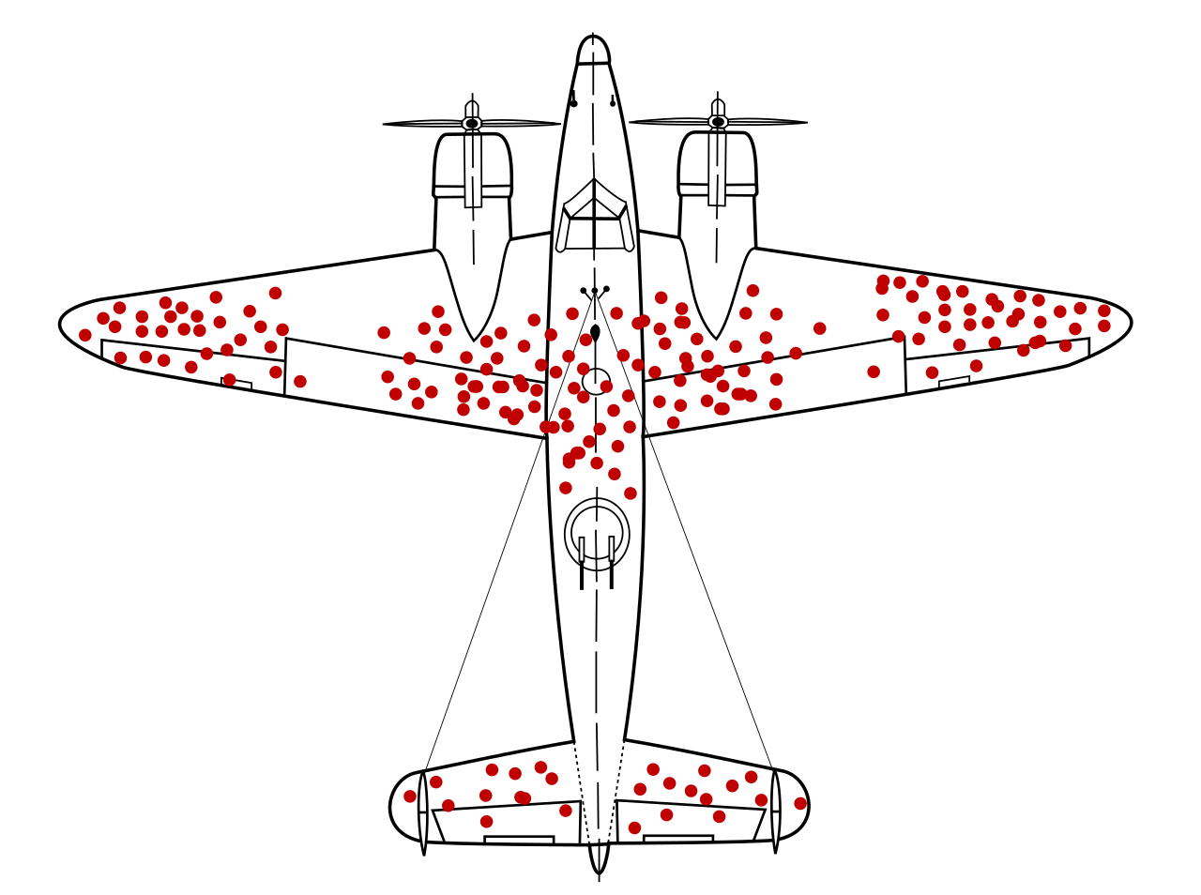
That one example with the plane
It’s World War II, and a bunch of planes came back. Red points refer to positions where those planes were hit.
Where would you put additional armor to better protect the planes?

Slide 80
What’s a sample?
1
In statistics, we are often interested in discovering characteristics and patterns in some population
In reality, you are unlikely observe every person/object/entity in your population
  Too costly, too long, too complicated…
  Imagine if you had to interview 60 million people in France whenever you want to conduct an election poll
A way to remedy this: we take samples, subsets of this population
Notes:
Do you know what a sample is?
Most data sets will be sample from a population

Slide 81
Sample selection bias
1
Your sample should look like your population… but what if it doesn’t ?
That is sample selection bias: the analyses can be valid for your sample, but cannot be generalized to the whole population
Worse: you may find correlations within your sample that are not present in the population
Accidental selection bias
You can create this problem yourself when you incorrectly split your data in two train-test datasets.
Make sure your splitting is random (or, ideally, stratified) and that the two samples are somewhat similar
Notes:
That’s a big problem, because in the first place, you want to gather information about the population. You are not interested in the sample in itself, that is just a convenience, you are interested in the whole population.

Slide 82

An example through questionnaires
1
You send a questionnaire on workplace diversity, equality and inclusion (DEI) to a firm. This is the data you observe for one question
Are you favourable to hiring quotas?
(i.e. having a minimum percentage of workers with specific sociodemographic characteristics)
Disagree
Agree
Notes:
Master 2 internship thesis (in another master programme (: )
Subject was about discrimination in the workplace, gender-based violence, inclusivity, etc.

Slide 83
1
Are you favourable to hiring quotas?
(i.e. having a minimum percentage of workers with specific sociodemographic characteristics)
Disagree
Agree
Logistic regression
(Dependent variable = favourable to quotas)
Variables distributions
Variable | Adjusted Odds Ratios
Gender (ref. women)
Men | 0.98
Age (ref. -40)
40-60 | 0.91**
+60 | 0.84***
Variable | % (sample) | % (population)
Gender
Men | 40 | 60
Age
-40 | 65 | 40
40-60 | 15 | 20
+60 | 20 | 40
Notes:
What do you think about these results?

Slide 84
Directed Acyclic Graph (DAG) time
1
This is a case of colliding bias
When two variables cause a third one, you do NOT want to condition on it: it distorts the association between the first two variables
But here you are forced to condition on participation to the questionnaire, because you cannot observe people that do not respond
Participation to questionnaire
Causes
Causes
Gender
DEI favourability
Notes:
That thing is a DAG. It’s used to represent causal relationships.
Here: men could be less likely to respond to questionnaires in general, and less likely to have a positive opinion to DEI topics. Likewise, people unfavourable to these topics will be less likely to respond to the questionnaire.
You are less likely to observe men, and people unfavourable to DEI in your sample
Participation to questionnaire is like a variable you are FORCED to include

Slide 85

1
Are you favourable to hiring quotas?
(i.e. having a minimum percentage of workers with specific sociodemographic characteristics)
Disagree
Agree
This could be the true distribution of the variable if we observed the whole population. What may possible be at work here:
  Sample selection bias
  Self-selection bias: people select into taking the questionnaire
  Social desirability bias: tendency to provide socially favourable answers to conform to perceived social pressure (i.e. you respond what you feel you are expected to respond)
A lot of biases intersect. You can have multiple problems happening at once.
Notes:
Self-selection bias: whenever there is a decision to participate, there is usually a whole mechanism that lead you to this decision, based on your personal values, opinions, behaviours… This is why we usually use randomization, and frequently recall people to participate.

Slide 86
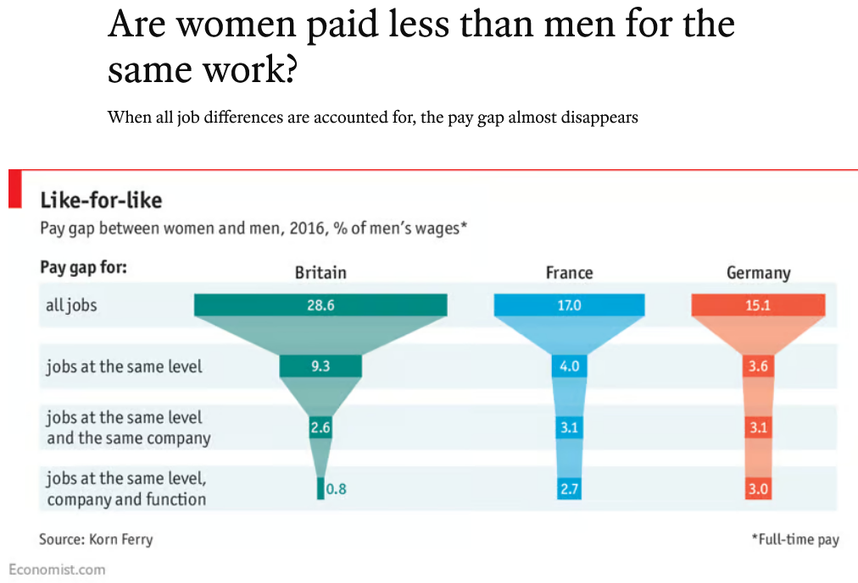

A word on colliding
Counterintuitive concept: you can introduce bias by including more variable into your analysis.
Classic example: the gender pay gap.
(2017 article)
Notes:
This is something people struggle to grasp: including more variable may not « reduce » bias, it can make it even more apparent.

Slide 87

Ok so no discrimi—
Example of colliding bias in Causal Inference: The Mixtape using simulation data.
Data generating process:
Ability ~ N(1, 0)
Discrimination = Female = 1
Occupation = 1 + 2*Ability – 2*Discrimination + N(0, 1)
Wage = 1 – 1*Discrimination + 1*Occupation + 2*Ability + N(0, 1)
Causal effect of discrimination on wage should be -1 in this model.
Notes:
Four components in this toy model: innate ability, discrimination (0/1), Occupation, Wage
1: innate ability, totally random
2: all women experience discrimination
3: Occupation is better as ability increase, but worsens when faced with discrimination
4: Wage decreases with discrimination, increases with better occupation and ability. That is what we want to estimate!

Slide 88
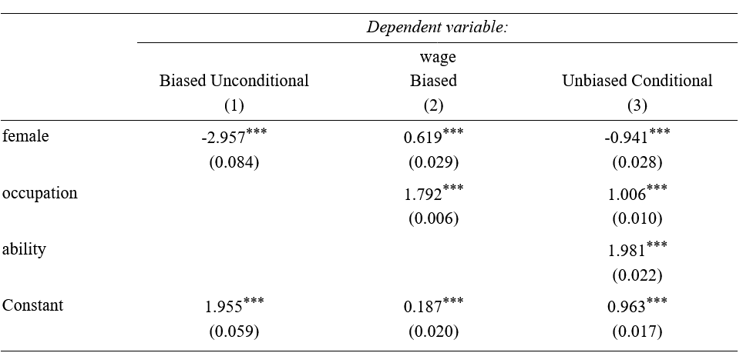
First regression: naïve
Discrimination
True model:
Ability ~ N(1, 0)
Discrimination = F = 1
Wage = 1 – Discrimination + Occupation + 2*Ability
Occupation = 1 + 2*Ability – 2*Discrimination
Female
Wage
Coefficient is -3 because you get the total effect of being female on W
  -1 is the direct effect of discrimination on wage
  -2 is the indirect effect of discrimination on wage, through occupation
Notes:
So the naive method: you just take your wage as a dependent variable, include discrimination (or female var, it’s the same thing), and regress.
You get -3. You know it is biased, because in the true equation it should be 1. So you get two effecs in one: the true effect of discrimination on wage, and something else…

Slide 89
Introducing occupation
Let’s introduce the occupational variable
Discrimination
True model:
Ability ~ N(1, 0)
Discrimination = F = 1
Wage = 1 – Discrimination + Occupation + 2*Ability
Occupation = 1 + 2*Ability – 2*Discrimination
Female
Wage
Occupation
You might expect the coefficient of discrimination to become -1
Coef is +0.6! You earn more money as a woman. Why?
Notes:
First, occupation has an effect on wage. But in the model, discrimination also affects occupation. So discrimination has a direct effect on wage (Discrimination -> Wage), and an indirect effect through Occupation which acts as a mediator (Discrimination -> Occupation -> Wage).

Slide 90
Ability: a collider
Discrimination
True model:
Ability ~ N(1, 0)
Discrimination = F = 1
Wage = 1 – Discrimination + Occupation + 2*Ability
Occupation = 1 + 2*Ability – 2*Discrimination
Female
Wage
Occupation
Ability
The culprit is ability. Including occupation opened a backdoor path. The effect of ability on wage is introduced because it influences occupation.
Ability vary, but the model does not account for it, so the total effect of ability on wage is reflected in the other coefficients of the model. They become biased.
Notes:
First, occupation has an effect on wage. But in the model, discrimination also affects occupation. So discrimination has a direct effect on wage (Discrimination -> Wage), and an indirect effect through Occupation which acts as a mediator (Discrimination -> Occupation -> Wage).
However, in this model, ability (which is unobserved) affects both occupation and wage. If we include occupation, it now acts as a collider variable between Discrimination and Ability, and the correlation between wage and discrimination becomes spurious because we need to control for ability (it’s effect on wage is now in both the female and occupation coefficients). This is a type of omitted variable.

Slide 91
Full model
Discrimination
True model:
Ability ~ N(1, 0)
Discrimination = F = 1
Wage = 1 – Discrimination + Occupation + 2*Ability
Occupation = 1 + 2*Ability – 2*Discrimination
Female
Wage
Occupation
Ability
Including ability solves the issue
  Realistically however, we cannot measure ability accurately
Think twice before including variables
Notes:
Now in reality, we don’t observe ability. Which is why estimating the GPG is a lot harder than this toy model.
This is only due to Ability -> Occupation. If you excluded ability from the equation of occupation, you would get the true effect of discrimination on wage only by including the occupation variable! The model would be less precise (i.e. more variance), because you don’t take into account ability, but the coefficients would still be unbiased!
The point is: you may introduce even more bias by including some variables.

Slide 92

Assignment bias
2
Let’s say you want to implement a job training program and see its impact on wage
Enrolment is voluntary, people decide to undertake training, and you create some control group of people not undertaking it
You now have your two groups, and you compare the average wage between both a few months after the training has ended
Do you think you estimate the true effect of the training on wage?
💸 💸 💸 💸 💸
Problem: there could be characteristics that lead people to select into training (motivation, resources or lack thereof, information…)
Notes:
In this case, you can’t know if the effect of the training variable on wage is due to the training itself, or due to some other characteristics of the training group that led them to undertake training.

Slide 93
Assignment bias
2
Assignment into groups should be random if you want to measure a causal effect, the people between the two groups should be exchangeable
Sometimes you can’t avoid it!
  This is why it is very hard to measure, for example, discrimination (based on gender, race, ethnicity…)
  If you want to measure that, you need to compare people from one group to the other
  But people will inherently belong to one group or the other, you can’t mimic random assignment, and they might not be exchangeable!
Notes:
On top of that, being of a certain stratum of society may be correlated with other unobserved variables, etc. etc.

Slide 94
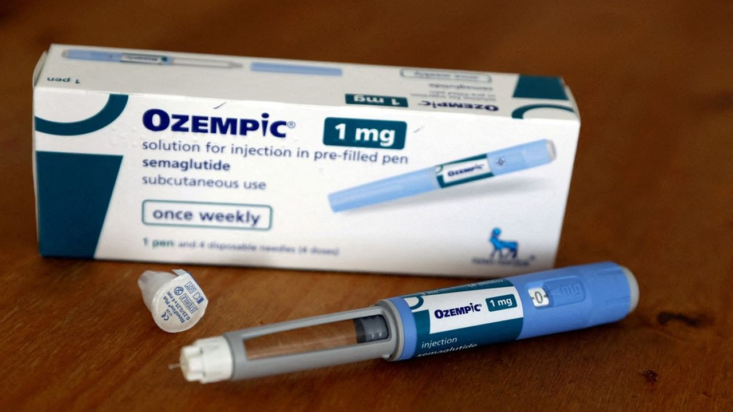
Adherence
3
This one is more about experimental designs
Imagine you want to analyse is the impact of taking Semaglutide (Ozempic, Wegovy) on weight. The 6-month protocol specifies:
  Subcutaneous injections twice a day
  Weekly appointment to a lab for a blood test and weight measurement
You take random samples of 10k people that will receive Semaglutide, 10k people that will receive a placebo

Slide 95

Don’t wanna do it anymore
3
Compliance with the protocol is paramount. But many things can happen in a 6-month span:
  Participants can decide to not take any medication, or less of it (1 injection instead of 2)
  Participants can involuntarily stop taking the treatment: random life problems, side effects of the drug…
  Or… die
So… treatment is not the same among everyone!
Analyses can be made on:
  The fully compliant subset. May be biased, since the selection is not random!
  Everybody (an “intention-to-treat” analysis). Here, you also include the effect of non-compliance on the outcome, through the treatment variable.
Notes:
ITT can be viable IF the factors leading to lack of adherence in the study are similar to those in the real world (possibly, reasons that lead participants to not comply to a treatment in a study will be the same among patients in real life).

Slide 96
Measurement errors
5
4
Measurement error is a general term for incorrectly measured variables, Weisberg distinguishes two cases:
  Exposure ascertainment: distortion in the treatment variable, the one for which you want to know the effect on the outcome
  Outcome measurement: distortion in your dependent variable of interest, your outcome
We will see a few examples of situations where people may not respond correctly or transmit wrong data
X
Y
Notes:
It comes actually in a lot of different forms

Slide 97

Recall bias and social pressure
5
4
People are likely to have problems recalling things (recall bias) and to be subject to social pressure and expectations
Imagine I asked you how many times, in the last two months, you have been binge drinking (5+ drinks over a few hours) :
  Depending on your alcohol consumption, you may not remember the
  true figure
  Heavy drinkers may be likely to underreport their alcohol consumption due to social stigma
Notes:
Non-drinkers, or people who drink occasionally, I would expect a true response. ➔ Possible underestimation of the true prevalence of binge drinking

Slide 98
Desirability bias
5
4
In 2017, we asked nurses who got vaccinated against influenza how important was patients’ safety and collective protection in their vaccination decision, on a scale of 1 to 10
  Average answers were around 9/10
You could argue it is their job, but it is possible they feel expected to give a high answer, as this is how we expect nurses to act
This is why, sometimes, too direct questions do not work
  A better indicator on how nurses value patients’ health would be to ask multiple behavioural questions related to patients’ health and build a latent variable

Slide 99
Incentives
5
4
Earlier in the class, I showed you a measurement error in severity variables reported by emergency services
If you wanted to measure the true effect of disease severity on length of stay in an emergency service, you could not:
  Some services have a financial incentive to overestimate the severity of some patients’ diseases
  The effect of severity on length of stay becomes distorted

Slide 100
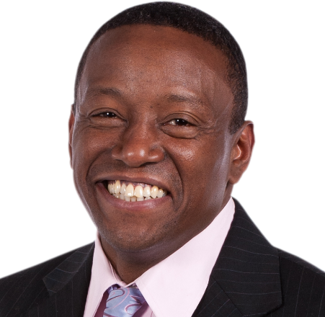


Proxy reporting
5
4
A proxy is an intermediary, a substitute
Let’s say you want to gather data about Roger, but you can’t ask him directly (he is not there, He is sick…)
  Solution: look for a secondary source, like his roommate Alain, or his mother Solène
Problem: they might not know the “real value”… or might (un)consciously lie about it
You must include this proxy in your modelling (as a binary variable, for example)

Slide 101
The CARE study
5
4
DREES: CARE study (Capacités, Aides et Ressources des séniors)
  Goal: assess seniors’ needs for help in their activities of daily living (health-related if they need help eating, showering, etc. etc.) and if their needs are met
The DREES sends people to administer a questionnaire to seniors at their home
  Some cannot physically answer, for health-related reasons
  In this case, they ask their spouse, children, or friends
  What do you think would happen if we just didn’t bother interviewing them?

Slide 102
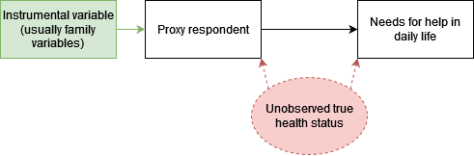
Proxy reporting: example
5
4
For each senior, we want to know if they need help in their daily life, and if their needs are met
Proxies were usually the caretakers of the person we wanted to interview
What do you think happens when you ask a caretaker questions about the people they care for? Notably:
  How much help they need
  How many of their needs are met
Unsurprisingly, proxy respondents overestimate both

Slide 103
Proxy reporting: example
5
4
Also, there’s endogeneity
  The unobserved true health status is called a confounder, here
Omitted variable bias: health status influence both usage of a proxy, and the needs for help in daily life (and will be reflected in both coefficients if you don’t include health status)
Notes:
It’s also called a confounder variable: if it is not included in the analysis, it creates spurious correlations between the variables it determines

Slide 104
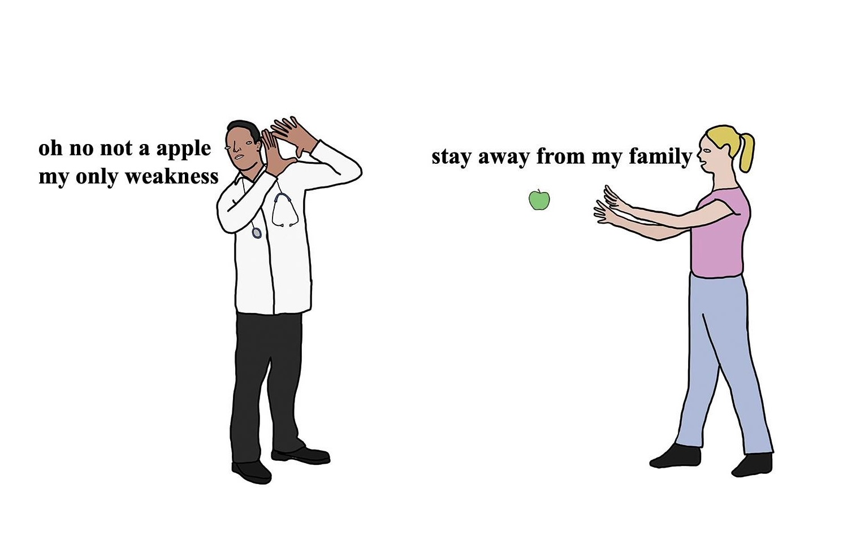
Solutions to bias
Best solution is prevention: proper randomization, careful selection of target population, procedures to avoid measurement errors, pilot testing questionnaires, verifying your data collection tools...
  Some bias may only be solved by proper planning: for example, if you know there will be a measurement error in one of your variable, you need to plan for an instrumental variable
There are way too many solutions that are context or industry-dependent to give an exhaustive summary here of how to tackle bias
Nevertheless, Weisberg (again) give some broad families of solutions for you to follow
From Chris
(Simpsons artist)
Notes:
I won’t list ALL of them, some are quite difficult (and I don’t feel technically good enough to vulgarise the most complicated ones), but you’ll get those that are perfectly doable by junior DS.

Slide 105
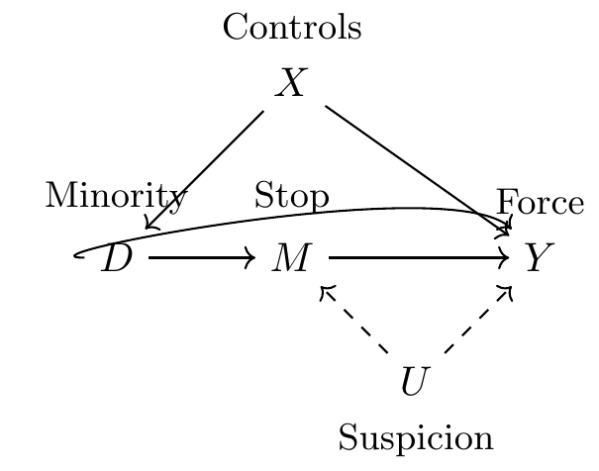
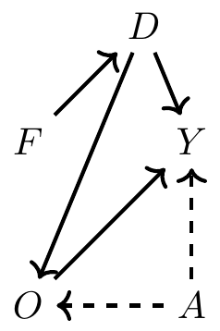
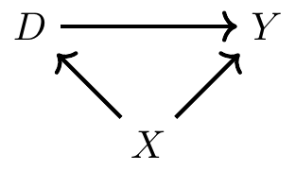
Back to the drawing board
1
You suspect you have some bias problem in your data?
Take your eyes off the data and do a DAG (those diagrams we saw earlier)
  See Causal Inference: The Mixtape for a full and easy explanation on how to do one
The point is to have a clear map of the assumptions and relationships you suspect in your data
Notes:
Plus it is also a good communication tool. It’s not really popular in econometrics for some reason (and I don’t know why)

Slide 106
Take it step by step (1)
2
Another tip if you suspect confounding or colliding:
  Instead of only fitting your full model, add variables one by one
  Be wary of the sequence you follow to include variables
Notes:
Here, if you included ability first instead of occupation, you would have a different bias in the female & ability variables (they would both include indirect effects: occupation on wage through being a woman, occupation on wage through ability)
You can have a look at how coefficients vary as you add your covariates

Slide 107
Take it step by step (2)
2
An alternative:
  Estimate your full, final model
  Fit another one, with other (or new) candidate confounders while keeping your variable(s) of interest
  Check how the coefficients on your variable(s) of interest vary
  If they do, keep the new model, otherwise keep the initial one
Do note that, underneath this approach, there is the (untestable) assumption that your full model (or the competing one) is correct!
Be careful with your interpretations

Slide 108


Sample weighting
3
The idea:
  You have a sample from some population, but it is not representative of it, or you have two groups (e.g. control and treatment) which are different
  Goal of weighting is to assign weights to individuals such that some of them “matter” more or less than others in analyses
Sample
Sample weights
(i.e. each individual counts for)
Population
1.25 individuals in the population
5 individuals in the population
Notes:
Sampling error can happens even with stratified sampling (i.e. sampling people randomly according to some characteristics, like gender, age, socioeconomic status, etc.)
It’s a simple example but this can be done on multiple variables

Slide 109
Sample weighting
3
Very versatile: use that whenever you want a group of observations to look like another group of observations
  Example: non-response in a longitudinal survey? You can use weights to correct this, such that the respondents look like all the respondents at the beginning on the survey, on the characteristics you like
Using sampling weights requires specific methods for data analysis: see survey package on R
Caveat: you need to know what the other group (or your population) looks like
Notes:
Ex in a longitudinal survey: the most busy people stop responding at some point. If you can identify who they were, you could add more weight to the busy respondents that still respond.

Slide 110

Propensity score weighting
3
You can create weights that represent the probability of being into a group conditionally on some characteristics
  This is the idea behind propensity scores, and inverse probability weighting
  You model the probability of being into one group (the treatment group, for example)
So if you hear about propensity score matching in one of your classes, this is one of the ideas behind this method:
  The “matching” part being: you match people from both groups that have close probabilities of being assigned to the treatment group, because they are comparable!
Notes:
The point is to mimic what you would have achieved with a randomised controlled trial, by making the two groups « balanced » (~comparable to one another) based on some observed covariates (of course it won’t work on unobserved covariates… because you don’t have them in your data.)

Slide 111
Limits to weighting (1)
3
Your sample will become representative of the population on the variables you selected to create weights
This may increase representativeness on other variables, if these are correlated with the variables you weight on…
Or the opposite:
Sample
Sample weights
(i.e. each individual counts for)
Population
1.25 individuals in the population
+
+
+
+
+
-
-
-
-
-
-
-
5 individuals in the population
(biased if you don’t take into account the +/-)

Slide 112
Limits to weighting (2)
3
This becomes a problem when the variable you do not take into account in your weighting is correlated with what you want to measure
There is a fancy name for this: the Conditional Independence Assumption (CIA)
Sample
Population
+
+
+
+
+
-
-
-
-
-
-
-
Notes:
Note: you cannot test CIA, because you can’t test that something unknown affects your weighting. So everytime you do weighting, you do a leap of faith and assume there is no more hidden phenomenon affecting both your assignment to treatment or sample selection and your outcome of interest.

Slide 113
Sensitivity analyses
4
The idea behind sensitivity analyses is to create an alternative scenario to see how your main results vary when changing your analyses. It could be:
  Another model: a proxy variable, other covariates
  A new estimation method: another type of regression, non-parametric models…
  Other things: another sets of weights, a new assumption…
The goal is to reduce the uncertainty around bias; the idea would be to answer the question: “how large could my bias be?”, or “how much off the mark could I be?”

Slide 114

Example with vaccination delays
4
In one of my papers, I estimate vaccination delays for some vaccine among nearly every child born in France since 2015.
“Nearly”, because I can’t observe around the vaccinations of 10% of children, mainly for poorer families, who may go to specific vaccination centres.
Some reviewer rightfully remarked that my estimates could be biased due to not including these 10% (sample selection bias, here)

Slide 115
Example with vaccination delays
4
To solve that:
  I modelled how the vaccination delay would be among the other 10% of children
  I assumed nearly everyone of them would be vaccinated fully (98%), and had significantly lower delays than other children (twice as low)
  Made my results more credible: overestimation of average delays were marginal (a few days, at most)
Sensitivity analyses will require you to make assumptions:
  You could make realistic assumptions to prove your point…
  Or demonstrate it ad absurdum: make very unrealistic assumptions, if you observe the bias is not that strong, this will make your main results more compelling
Notes:
So sometimes you will need to do some mathematical modelling or simulations to make your point.

Slide 116
Recalculating indicators
5
You have probably been told about endogeneity and how to solve this using instrumental variables that must satisfy the following conditions:
  Exclusion restriction: uncorrelated with the error term of the equation of interest (i.e. uncorrelated with the variable you don’t observe!)
  Relevance: strongly correlated with the endogenous variable
The point is this:
  You use this variable in an equation to “recalculate” the endogenous variable in such a way that it is not correlated to the omitted variable (or free of measurement error)

Slide 117

That proxy example again
The solution here is to recreate the proxy respondent variable
  The way to do so is to predict it using variables that are strongly associated with it (relevance), but that are not determined by the unobserved health status (exclusion restriction)
If done correctly, the new proxy respondent variable will be independent of the effect of the unobserved health status
  The coefficient for proxy respondent will be unbiased (or at least, not affected by the health status)
Notes:
It’s a pretty powerful tool, but instrumental variables are notoriously hard to find.
The other solution could be to find a proxy of the unobserved health status (i.e. a variable that can replace this health status). The hard part is finding it (and it may not be enough to correct the bias).

Slide 118
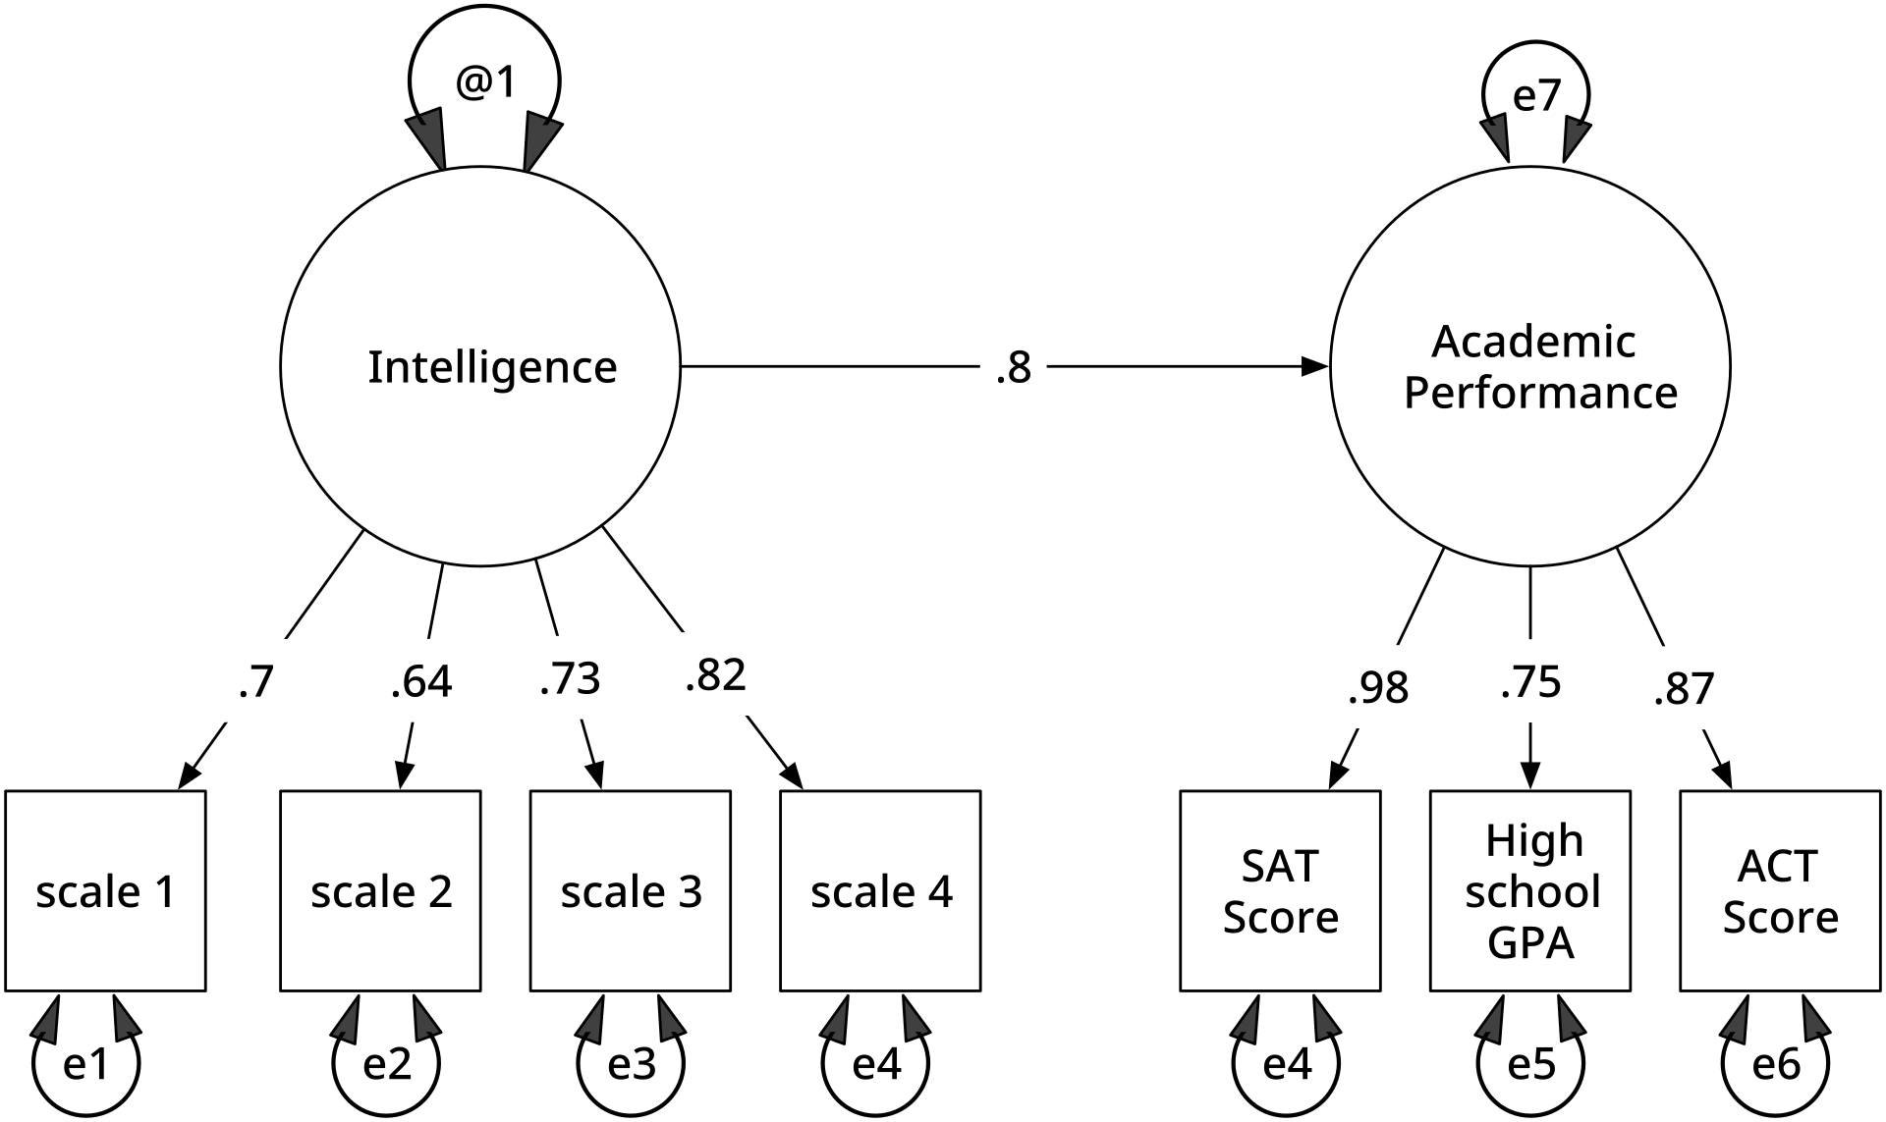
Other advanced methods
6
A few you could look into, when you gain more experience:
  Probabilistic bias analysis: use simulations to estimate a bias parameter
  Structural equation modelling (SEM): if you have a full theoretical model, SEM can be used to represent (and confirm) more complex causal relations among multiple variable (including latent ones)

Slide 119

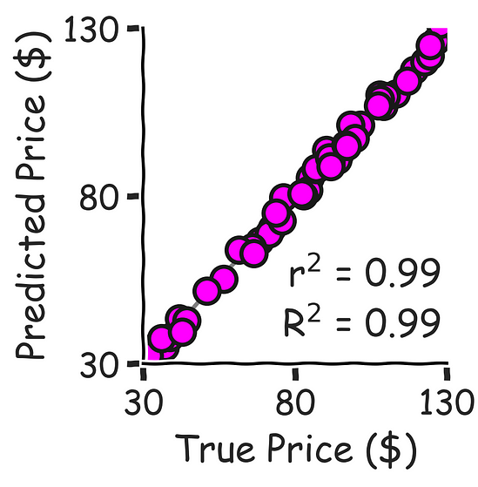




Statistical inference? In 2025? lol
“But Dimitri, idc about coefficients, I just want accurate predictions and HUGE metrics. So that involves INCLUDING. EVERY. VARIABLE”
😤😤😤
💸
💸 💸 💸 💸 💸
🚀
💸
Notes:
Well, that is fair. A lot of DS are mainly interested in making good predictions, choosing the best type of model and hyperparameters to optimise some metrics, etc. etc. You can have biased coefficients, but still have very good predictions with your model.

Slide 120
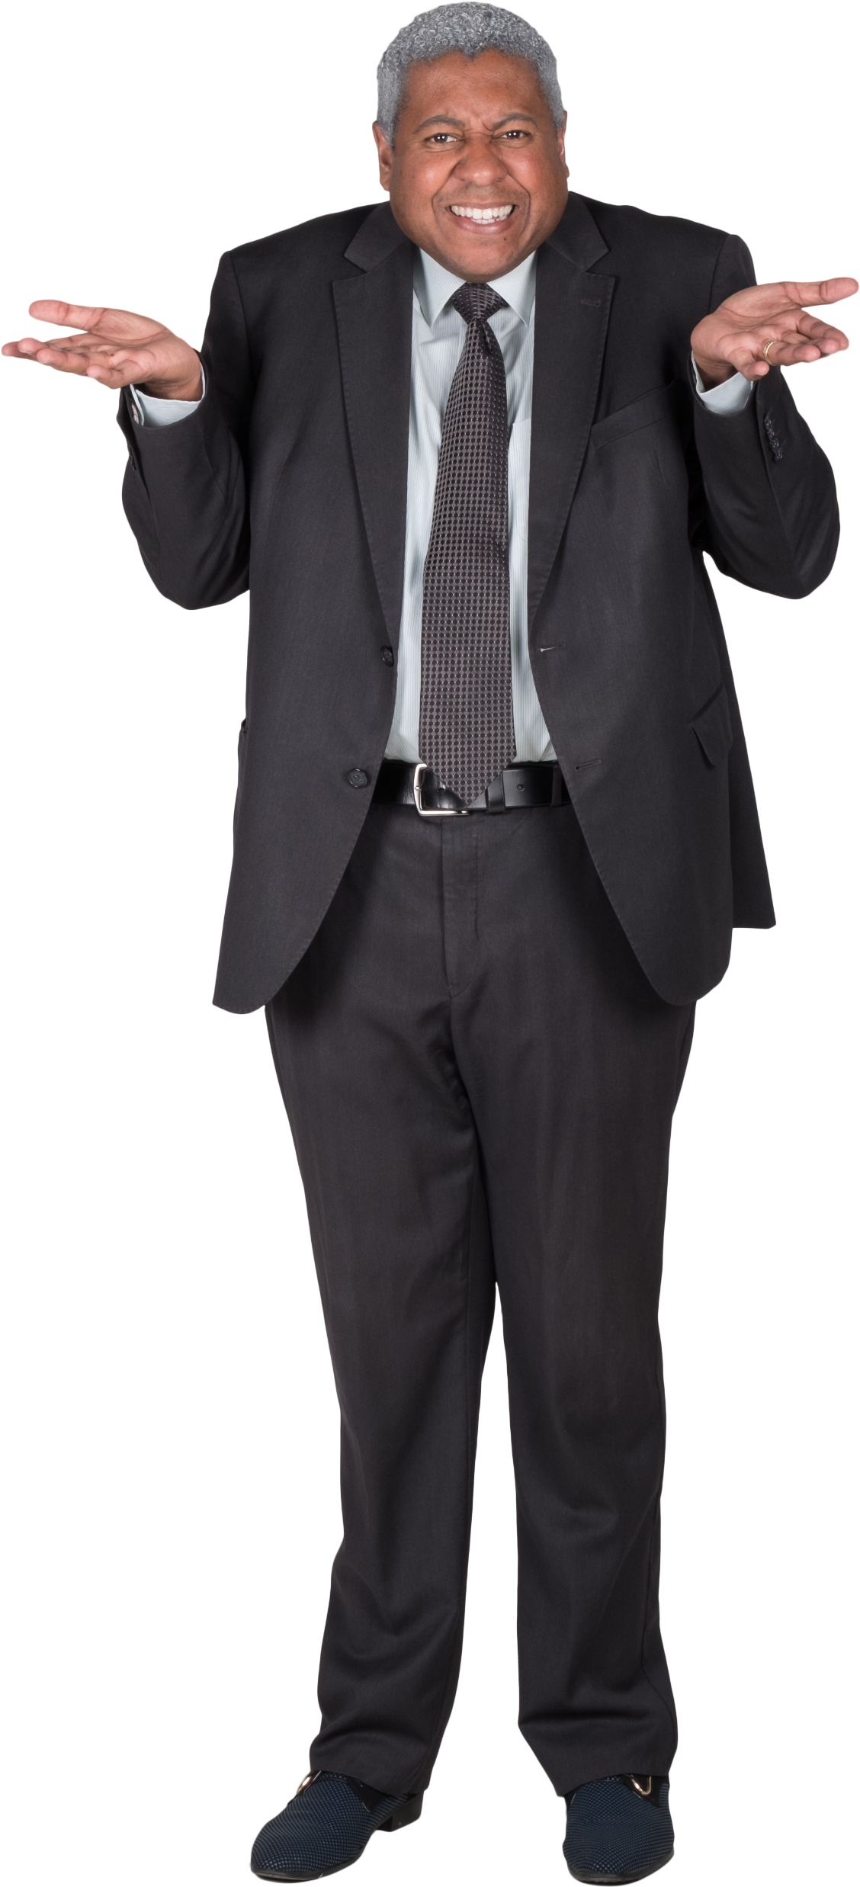
Causality in predictive ML
Ask a ML engineer how he takes into account endogeneity in his modelling
  Them:
Valid question:
  If your outcome is well measured and you only care about good predictions, why should you care about bias in your regressors?
haha
Notes:
Story about that lecturer who had no idea what it was
Or: why should you even try to understand your model if you only care about good

Slide 121
Rethinking true values
Studying bias in statistics has been fairly established and researched for decades
It makes sense: you use statistics to better understand reality and take decisions, so if you can’t accurately model the “true” values, what is the point of your work?
Since the beginning of the class, we have never questioned these “true” values:
  We take it as given that we should predict them
  But should we always?
Notes:
There is some obsession in data science about perfectly predicting values as they are in the data.

Slide 122
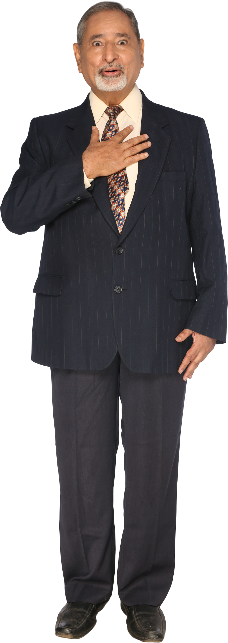
Warning
We will talk about fairness
This is a normative concept, what I think is fair
may not be fair for you, and vice-versa
Also, I often argue data science is inherently political:
  The data you work on can be people (my work does), or directly affect people’s needs or lives (my work also does)
  The decisions you take in your analyses can often be subjective or prone to errors
  The results you give decision-makers help them make (hopefully informed) decisions that ultimately affect people’s lives
Notes:
So this is the possibly controversial part of this course. The fact that it is political is something I imply quite heavy-handedly throughout the course when I talk about minorities, gender issues, etc. So don’t get shocked on me, right.
Fun stuff with data science: warfare, tracking and surveillance, face recognition, obscure recommandation algorithms that maximise the time you spent on a product (and not your well-being), advertisements, hiring, policing, deepfakes, social scoring systems

Slide 123
The state of fairness
To my knowledge, nobody talks about it in courses: not at the AMSE, not in the previous version of this class, not in engineering schools or in Data Science courses
At most you hear platitudes by engineers like “our models should not discriminate based on X or Y characteristics”
The subject of fairness is fairly recent, I discovered everything here recently, as I researched it in books
  Here, mostly Fairness and Machine Learning: Limitations and Opportunities
Notes:
Tbh, knowing about fairness won’t land you a job. I don’t think most DS people truly care.
Also, pessimistic me would argue that most of what companies say about fairness in their ML algorithms is mostly posturing, unless they are under regulatory constraints or under high public scrutiny.

Slide 124
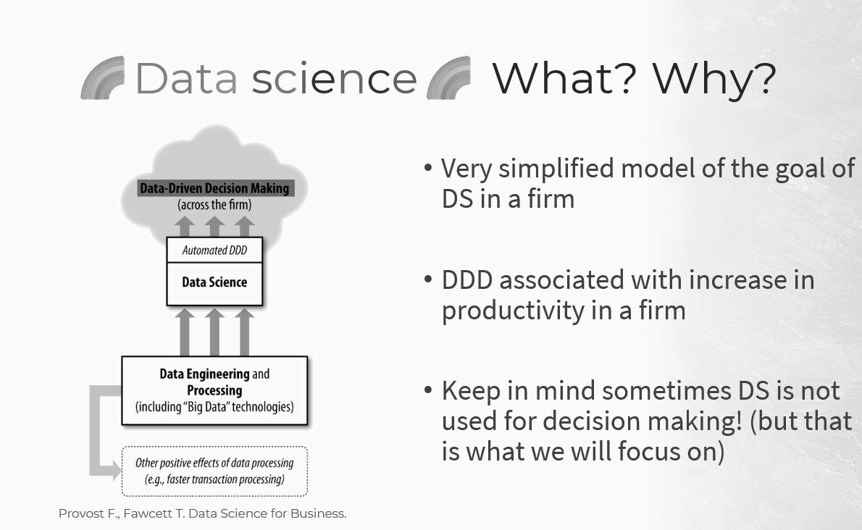
Ground truths and feedback loops
Notes:
First graph of the class (that I did not like). There are a few crucial things missing there.

Slide 125
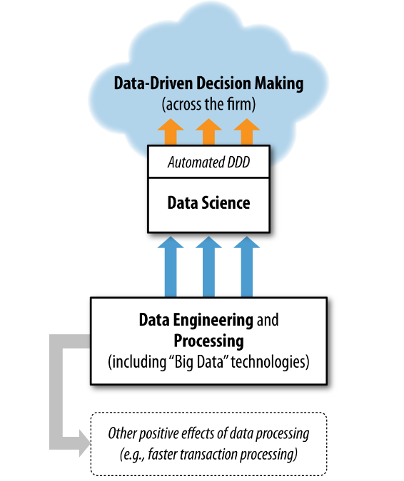
Ground truths and feedback loops
Action
Feedback
Ground truth
(or raw data)
Provost F., Fawcett T. Data Science for Business.
Notes:
This graph is very “firm” centric, like if it has no connection to the rest of the world, there is no context around it.
The action taken by the decision-maker (be it a human or a machine) does not exist in a vacuum. It has an effect on the ground truth that you observe and gather data from. That is called feedback. A feedback loop

Slide 126

Toy example: hiring people (1)
We are a company in a fictional world where people are either:
or
Hiring is made on the basis of predicted job performance, which we predict very well using ML and the following variables:
  GPA (i.e. average grades during your studies)
  An interview score
We have a minimum threshold of predicted job performance to hire people, this is an automatic process (a.k.a. “automated decision making”)
Notes:
Automated decision making, and also “decision support tool”, are very common. I create this for emergency services.
Also, example of COMPAS (Correctional Offender Management Profiling for Alternative Sanctions), is an algorithm in the US to predict a defendant’s likelihood to become a recidivist.

Slide 127
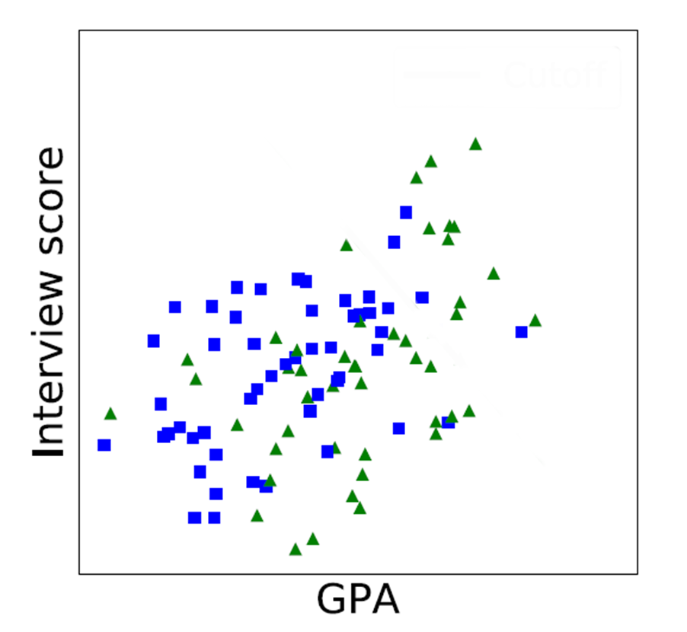
Toy example: hiring people (2)
This is a scatter plot of GPA and interview score
tend to have lower GPA, on average
Notes:
Why? Perhaps there is significant economic disparities between blues squares and green triangles, leading the former to worse educational outcomes.

Slide 128
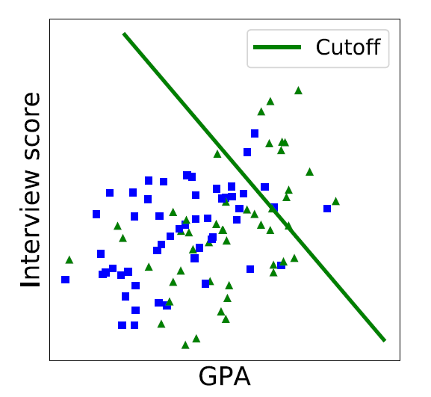
Toy example: hiring people (3)
This is a scatter plot of GPA and interview score
tend to have lower GPA, on average
The green line is the cutoff: anybody to the right can be hired
are less likely to be hired, overall

Slide 129
Toy example: hiring people (4)
Is it fair?
  On one hand, this is what you get in the data, the “ground truth”, and you don’t include being a blue square or a green triangle in your model
  On the other hand, there is an indirect effect of being a blue square on being hired through GPA (it’s a proxy!)
Notes:
So, on average, when being born blue, you can expect a lower chance of being hired. Because being blue places you in different “structural circumstances”: you are subject to a series of circumstances and decisions throughout your life which accumulate and coumpound.

Slide 130
Toy example: hiring people (5)
Imagine if every company started using the same methodology
Perhaps you could expect future applicants, in years, to change because of these hiring practices
That would be a feedback loop
Notes:
E.g. : even more economic disparity, leading to lower GPA among blue squares. That is kind of the idea behind systemic or institutional discrimination.
In turn, this reinforces the implicit discrimination in our model even more. The idea of a feedback loop: your decisions or output have an impact on the ground truth, ground truth which you then model again, etc. etc.
Feedback loop: that’s the same current problem with generative AI.

Slide 131
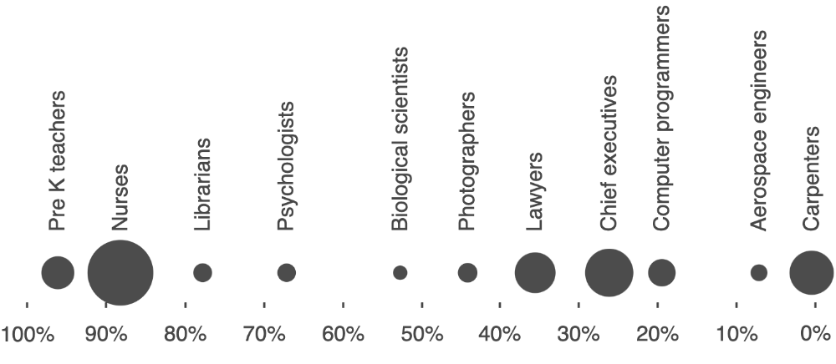
The state of society
Society is inherently rife with imbalances
Sample of occupations in the United States
More women
More men

Slide 132

The state of society
Society is inherently rife with imbalances
Socioeconomic deprivation level
Low
High

Slide 133
The state of society
These become properties of the datasets they populate
Depending on what you model, you may end up reinforcing these imbalances, biases, stereotypes or categorisations
Notes:
Imbalance: unequal representation of different groups
Bias: incorrect associations stemming social and historical prejudice
Stereotype: associations that reflect a property of the world that is thought to be the result of social and historical prejudice
Categorisation: assigning discrete labels to complex aspects of identity such as gender and race

Slide 134


The COMPAS example
dun dun
Decision support tool, used in some US courts, that predicts recidivism and misconducts among defendants
  Proprietary (i.e. closed source) statistical model behind it
  Multiple scores are calculated according to criminal history, education, substance use…
  Defendants are then categorized as low, medium or high risk, for ease of interpretation
2016 study:
  ProPublica (investigative journalism org.) showing a higher rate of false positives of violent recidivism among black defendants (vs. white defendants)
Notes:
Correctional Offender Management Profiling for Alternative Sanctions
Recidivism, among other things
Misunderstanding of statistical

Slide 135



Significant controversy
  Multiple articles in mainstream media (Le Monde, Libération, NYT, WaPo…)
  Original study cited around 4,000 times (Google Scholar)
  Still an ongoing subject of study among academic circles
This is problematic indeed:
  Is the algorithm truly fair, even if race is not a factor? How do we define fairness?
  I would add: do decision makers understand how predictions are made, and the limits of such models and scoring? Very complicated model can appear deceivingly simple
Notes:
Correctional Offender Management Profiling for Alternative Sanctions
Recidivism, among other things
Misunderstanding of statistical

Slide 136
So what’s fairness?
We will instead define unfairness (or discrimination):
  It’s a treatment that “systematically impose a disadvantage on one social group relative to others”.
Level | Direct discrimination | Indirect discrimination
Structural/societal | Laws against same-sex marriage | Better funded schools in wealthier, more segregated areas
Organisational | Lack of disability accommodations | Networked hiring
Interpersonal | Overt prejudice | Belief in need for innate brilliance (combined with gender stereotypes)
Problem: this deprives prejudiced groups of opportunities
Notes:
Sociologists distinguish three different levels:
Highest level: how society is organised
Organisational/groups:
Brilliance: in some very traditional sociocultural contexts,

Slide 137
Equality of opportunity
An approach to limit discrimination (with three competing views):
Score | Goal | Intervention point | Who bears the cost of uplifting historically disadvantaged groups
Narrow | Ensure people who are similarly qualified for an opportunity have similar chances of obtaining it | Decision making | No one
Middle | Discount differences du to past injustice, that account for current differences in qualifications | Decision making, especially critical life opportunities | Decision maker, who may pass on the cost to decision subjects
Broad | Ensure people of equal ability and ambition are able to realize their potential equally well | Government, on a continuous basis | Taxpayers

Slide 138


And in statistics? (1)
That’s… complicated. Let’s look at COMPAS again:
“Our algorithm is fair, positive predictions are equal among groups”
“The algorithm is not fair, false positive rates are unequal among groups”

Slide 139

And in statistics? (1)
https://medium.com/@lamdaa/compas-unfair-algorithm-812702ed6a6a

Slide 140
And in statistics? (2)
There are many fairness metrics, but no single best
  Plus, some are conflicting
The authors of Fairness and Machine Learning seem to mainly emphasize error rate parity
  Having similar true positive rates is desirable of course
  But false positives and false negative also have significant real-life implications
Ultimately, the metrics you will use depends on your project
  Sorry! (:
  Some resources to learn about metrics: Fairlearn, Fairness and Machine Learning, Fairness Definitions Explained

Slide 141
Advocating for interpretability and causality in ML
Complex, black box ML algorithms are very good at prediction, so much that they tend to preserve structural (dis)advantages, because these exist in the data
Causal inference help identify if decisions are taken according to legitimate factors, instead of spurious correlations
  Also, help identify how sensitive attributes matter in prediction, either directly or indirectly, and to create “what-if?” scenarios
Interpretability help identify how predictions affect groups
  Do different groups have different outcomes on average?
  Are errors in predictions comparable across groups? (error rate parity)

Slide 142
Read the book
Again, I can’t recommend enough the Fairness and Machine Learning book
  It goes deep into the subject of fairness in Data Science and decision making, and this (small) chapter does not do it justice
Great for anybody who would like to think critically about the impact of Machine Learning and data-driven decision making on people, the perpetuation of societal inequalities, etc.

